Slide 1
Analysis strategies for cytometry and cytokine data
Alexandra Roux, Fabien Pitoiset, Phuong Pham,
Nicolas Tchitchek and Michelle Rosenzwajg

Slide 2
Cytometry data

Slide 3
Overview of the collected dataset
86 patients (including Bulgarians)
41 placebo (26 R and 15 NR)
45 IL2-treated (31 R and 14 NR)
7 clinical centers
Bulgaria (002)
France (003)
Germany (004)
Portugal (007)
Romania (008)
Spain (009)
Mauritius (010)
6 time-points
V01: baseline (before treatment)
V05: D05
V09: D30
V17: M03
V29: M06
V30: M09

Slide 4
Overview of the collected dataset
59 patients (excluding Bulgarians)
27 placebo (12 R and 15 NR)
32 IL2-treated (20 R and 12 NR)
6 clinical centers
France (003)
Germany (004)
Portugal (007)
Romania (008)
Spain (009)
Mauritius (010)
6 time-points
V01: baseline (before treatment)
V05: D05
V09: D30
V17: M03
V29: M06
V30: M09
50 patients with V01 to V17

Slide 5
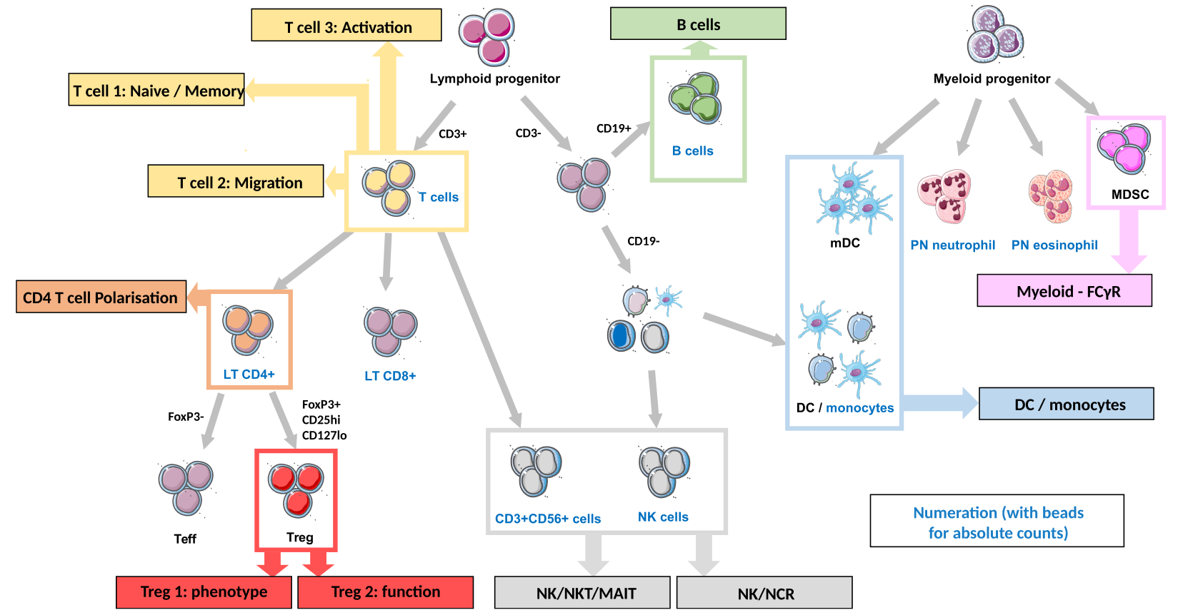
Overview of the cytometry panels
13 cytometry panels of 10 colors each to characterize:
• Panel 01 – numeration cells
• Panel 02 – B cells
• Panel 03 – NK cells
• Panel 04 – Naïve memory T cells
• Panel 05 – NK/MAIT cells
• Panel 08 – T cells polarization
• Panel 09 – T cells activation
• Panel 10 – Regulatory T cells (function)
• Panel 12 – Regulatory T cells
• Panel 13 – ILC

Slide 6
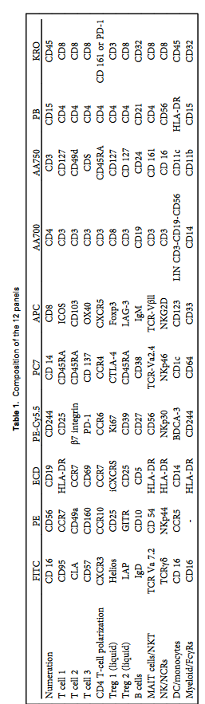
Overview of the cytometry panels
13 cytometry panels of 10 colors each to characterize:
• Panel 01 – numeration cells
• Panel 02 – B cells
• Panel 03 – NK cells
• Panel 04 – Naïve memory T cells
• Panel 05 – NK/MAIT cells
• Panel 08 – T cells polarization
• Panel 09 – T cells activation
• Panel 10 – Regulatory T cells (function)
• Panel 12 – Regulatory T cells
• Panel 13 – ILC

Slide 7
Overview of the collected dataset
445 samples
Panel 1
Panel 2
Panel 3
Panel 4
Panel 5
Panel 6
Panel 7
Panel 8
Panel 9
Panel 10
Panel 11
Panel 12
Panel 13
~ 440 samples collected per panel
~5,700 cytometry samples collected
≠ in sample numbers is explained by technical issues such as:
lack of Abs
small amount of blood
444 samples
444 samples
445 samples
445 samples
445 samples
445 samples
438 samples
445 samples
443 samples
445 samples
442 samples
440 samples

Slide 8
Overview of the analyzed dataset (gating)
100%
Panel 1
Panel 2
Panel 3
Panel 4
Panel 5
Panel 6
Panel 7
Panel 8
Panel 9
Panel 10
Panel 11
Panel 12
Panel 13
~ 2,000 hours of gating work
~ 700 gated populations
10 panels out of 13 have been analyzed (manual gating done)
all panels should be analyzed by the end of April 2020
100%
100%
100%
100%
75%
todo
100%
100%
100%
50%
100%
100%

Slide 9
Aim of the flow cytometry analyses
Understand the biology of the low-dose IL2 treatment
What cell populations are impacted by the treatment over time ?
Predict patient’s outcomes based on cell populations
What cell populations are associated at baseline with the clinical outcomes ?
Understand the synergy between cell populations
What are the interactions between the different cell populations?
How these interactions are linked to the treatment or outcomes ?

Slide 10
Analysis strategies
Supervised analyses (manual gating)
Univariate analyses
Multivariate analyses
Cross-panel multivariate analyses
Unsupervised analyses (automatic cell clustering)
Univariate analyses
Multivariate analyses
Cross-panel multivariate analyses

Slide 11
Analysis strategies
Supervised analyses (manual gating)
Univariate analyses
Multivariate analyses
Cross-panel multivariate analyses
Unsupervised analyses (automatic cell clustering)
Univariate analyses
Multivariate analyses
Cross-panel multivariate analyses
abundances fold-changes relative to baseline AUC (from V01 to V17)
abundances fold-changes relative to baseline AUC (from V01 to V17)

Slide 12
Supervised analyses (manual gating)
Cytometry data are analyzed using manual gating strategies to quantify abundances of known cell populations
Performed using Kaluza software
Analyses aiming at identifying cell populations impacted:
By the treatments
Between conditions
Across time-points
Initial steps of the gating strategy for panel 09
Initial steps of the gating strategy for panel 12

Slide 13
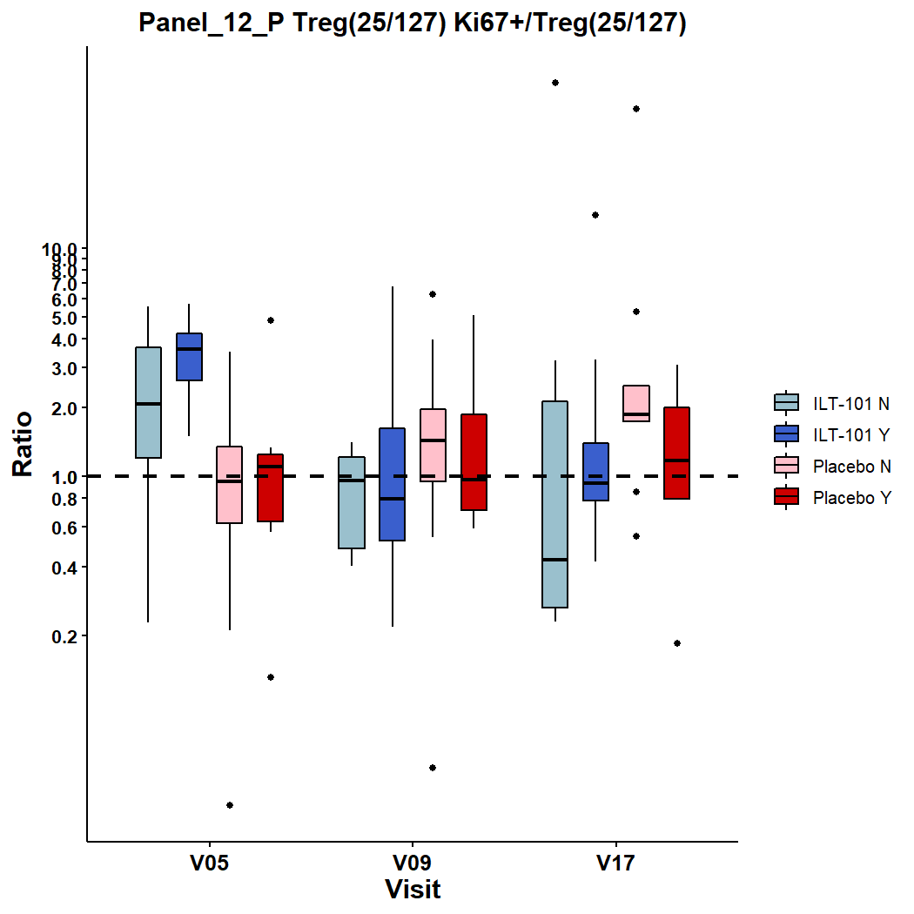
Supervised analyses (manual gating)

Slide 14
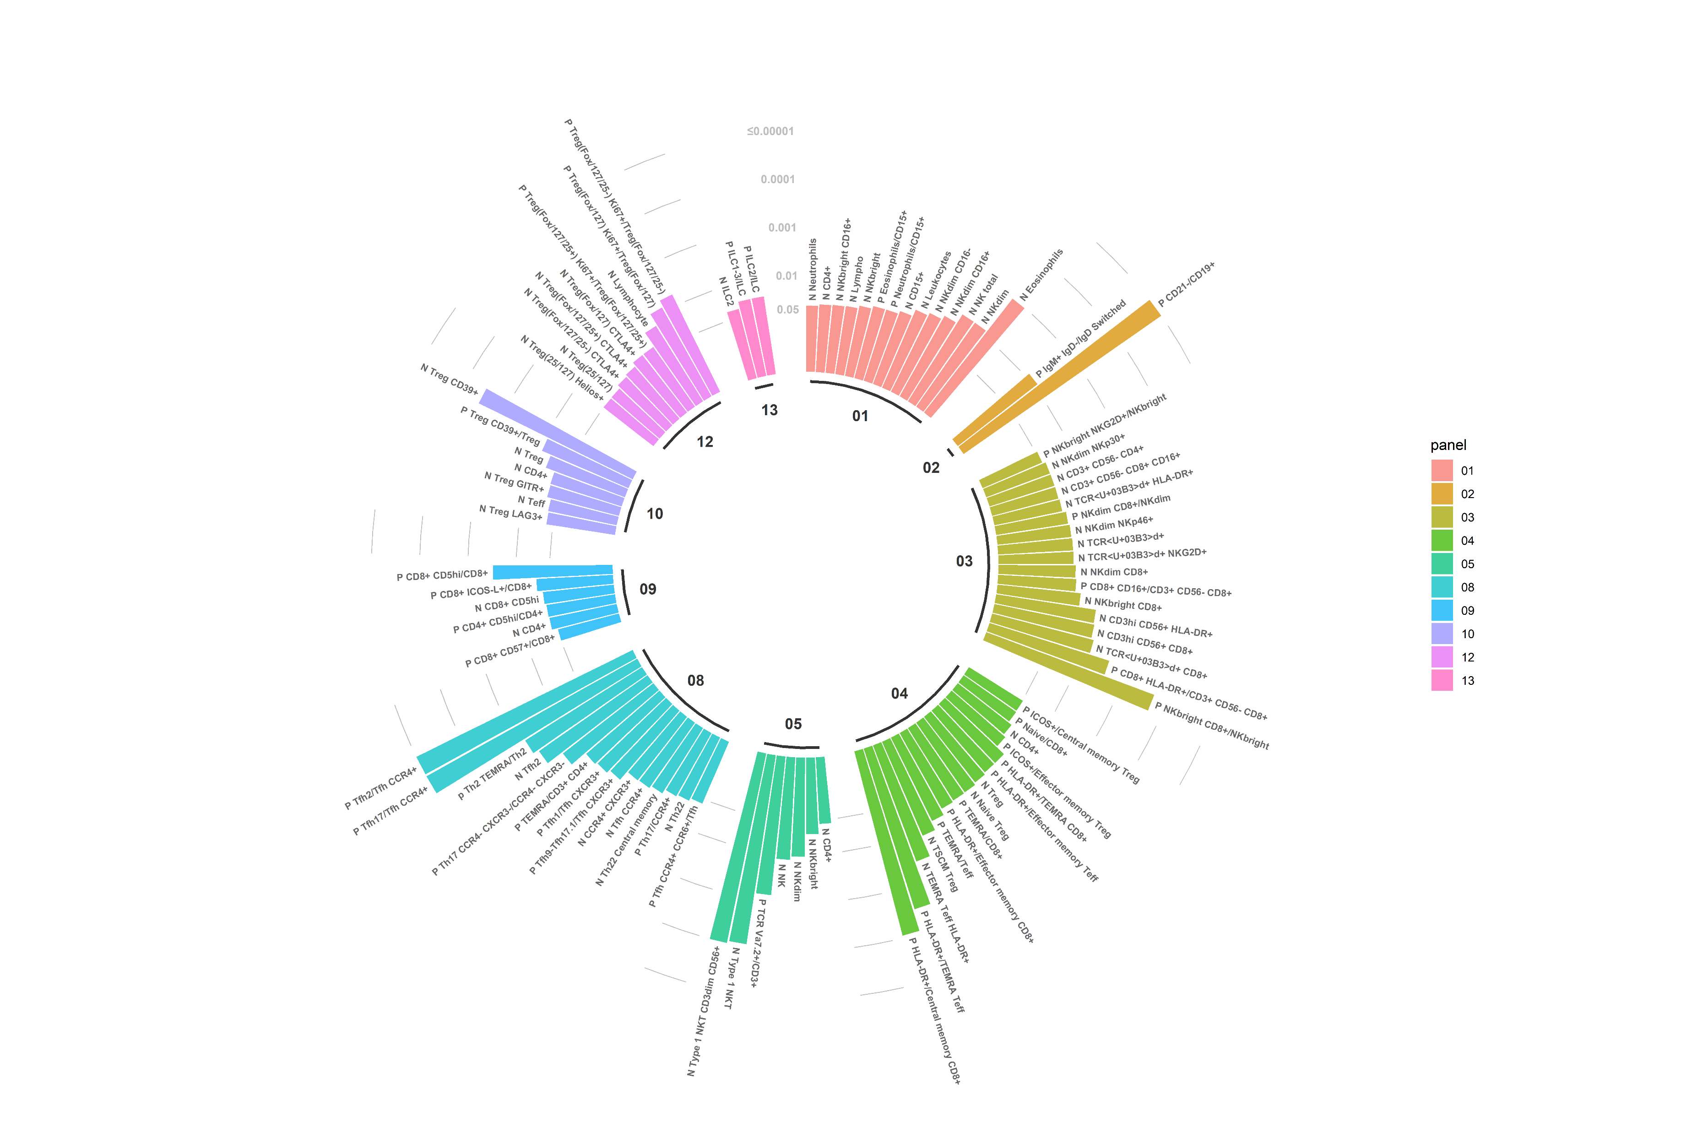
Supervised analyses (manual gating)

Slide 15
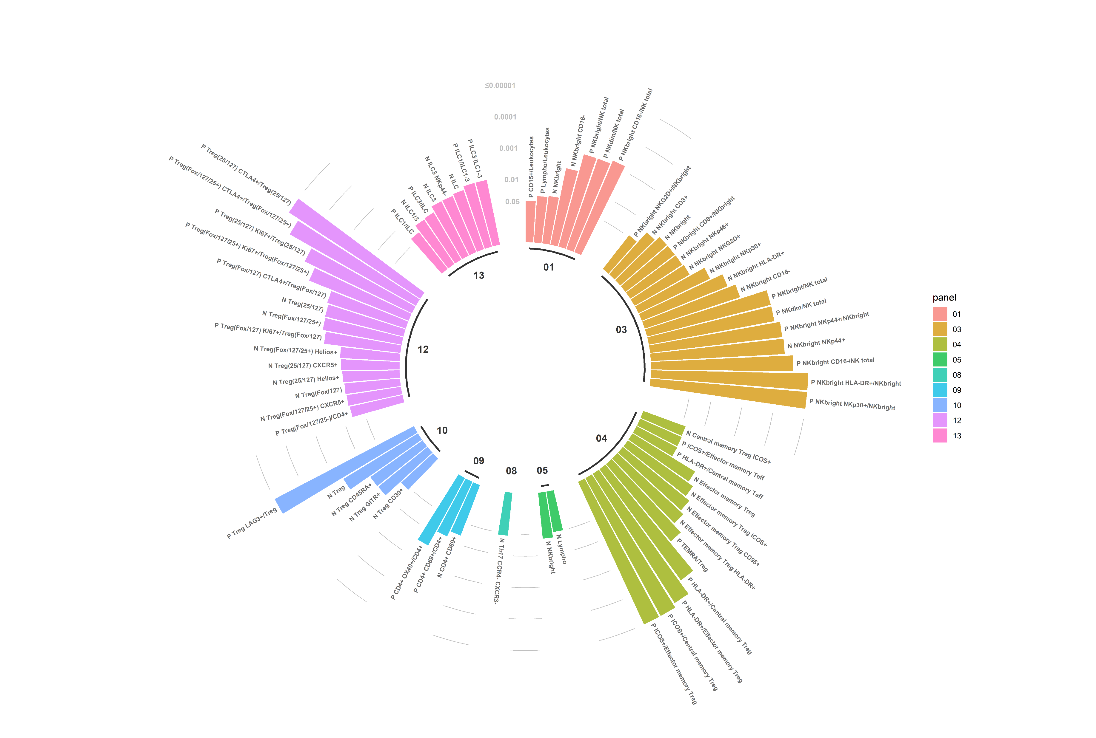
Supervised analyses (manual gating)

Slide 16
Unsupervised analyses (automatic cell clustering)
Two algorithms for automatic cell clustering
tSNE combined with kmeans clustering (viSNE, Amir et al. 2013)
SPADE (Qiu P. et al. 2011)
Two analytical pipelines
tSNEVizR (under development)
SPADEVizR (Gautreau et al. 2016)

Slide 17
Unsupervised analyses (automatic cell clustering)
Two algorithms for automatic cell clustering
tSNE combined with kmeans clustering (viSNE, Amir et al. 2013)
SPADE (Qiu P. et al. 2011)
Two analytical pipelines
Phenotypical analyses of identified cell clusters (marker expressions)
Analyses of cell cluster abundances for identified cell clusters (TP vs. BL)

Slide 18

viSNE/kmeans analyses
Barnes-Hut t-Distributed Stochastic Neighbor Embedding (tSNE)
tSNE representation

Slide 19
viSNE/kmeans analyses
Barnes-Hut t-Distributed Stochastic Neighbor Embedding (tSNE)
Each dot corresponds to a single cell
Cell are positioned based on their phenotype similarities
tSNE perplexity = 30
theta = 0.5
# of iterations = 1,000
tSNE representation

Slide 20
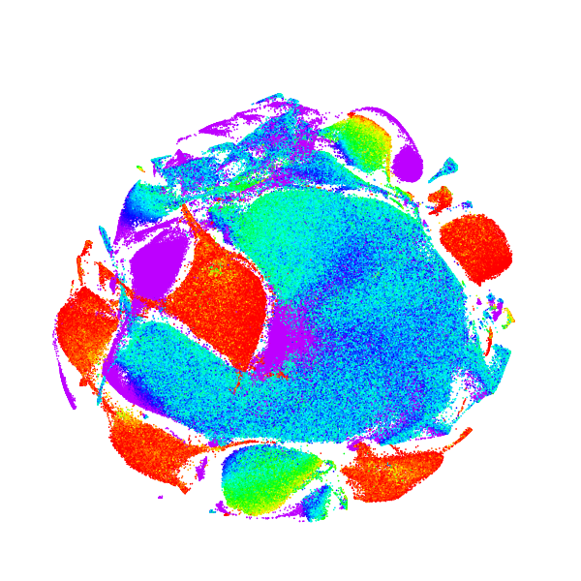
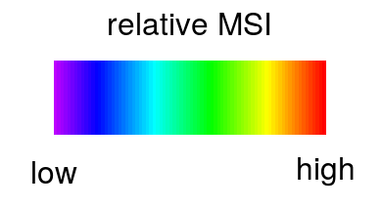
viSNE/kmeans analyses
Barnes-Hut t-Distributed Stochastic Neighbor Embedding (tSNE)
Each dot corresponds to a single cell
Cell are positioned based on their phenotype similarities
tSNE perplexity = 30
theta = 0.5
# of iterations = 1,000
tSNE representations are overlaid with cell marker expressions
tSNE representation overlaid by CD3 expression

Slide 21
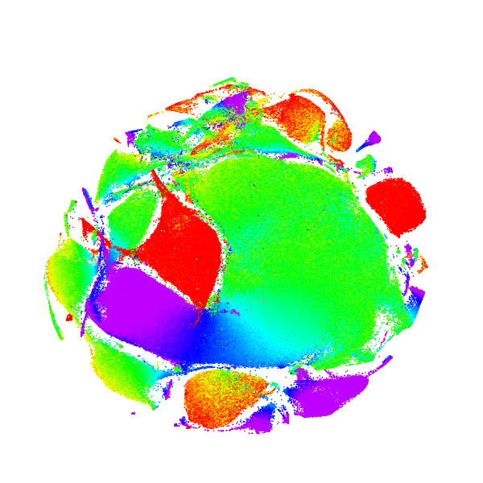
viSNE/kmeans analyses
Barnes-Hut t-Distributed Stochastic Neighbor Embedding (tSNE)
Each dot corresponds to a single cell
Cell are positioned based on their phenotype similarities
tSNE perplexity = 30
theta = 0.5
# of iterations = 1,000
tSNE representations are overlaid with cell marker expressions
tSNE representation overlaid by CD4 expression

Slide 22
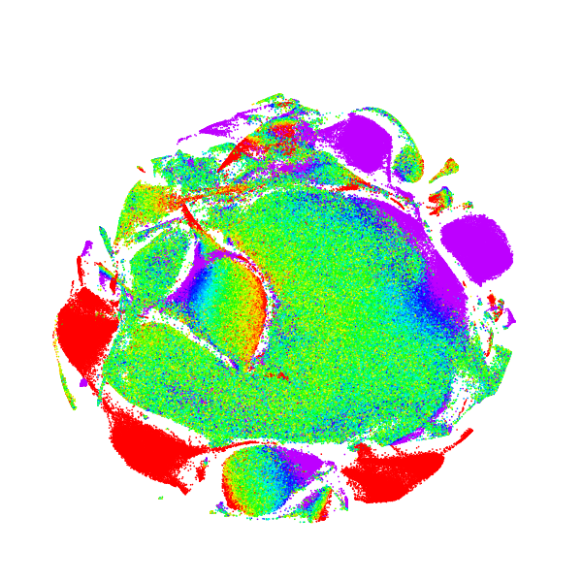
viSNE/kmeans analyses
Barnes-Hut t-Distributed Stochastic Neighbor Embedding (tSNE)
Each dot corresponds to a single cell
Cell are positioned based on their phenotype similarities
tSNE perplexity = 30
theta = 0.5
# of iterations = 1,000
tSNE representations are overlaid with cell marker expressions
tSNE representation overlaid by CD8 expression

Slide 23
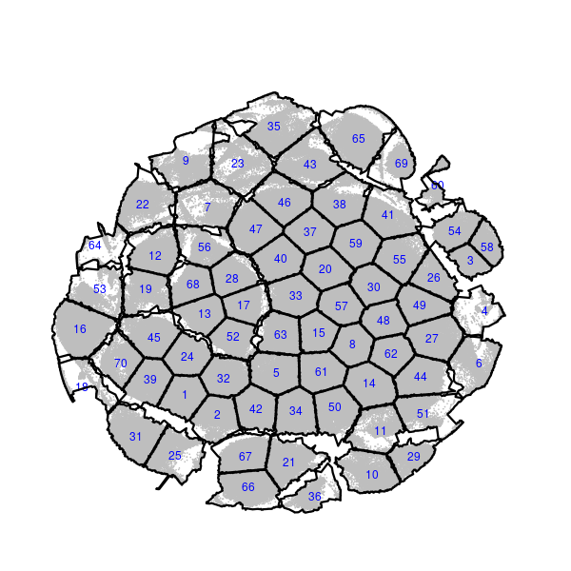
viSNE/kmeans analyses
Barnes-Hut t-Distributed Stochastic Neighbor Embedding (tSNE)
Each dot corresponds to a single cell
Cell are positioned based on their phenotype similarities
tSNE perplexity = 30
theta = 0.5
# of iterations = 1,000
tSNE representations are overlaid with cell marker expressions
A kmean clustering is performed to identify clusters of cells having similar phenotypes based on marker expressions
Concave hulls are created to delineate cell clusters
Cell clusters are arbitrary labeled with a number
tSNE representation overlaid by kmean-clustering assignment

Slide 24
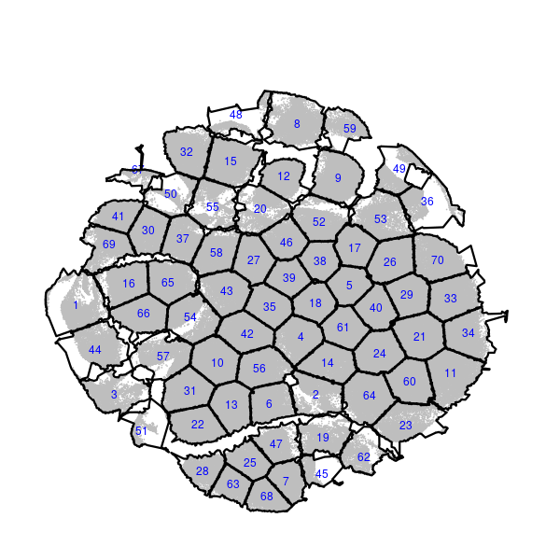
viSNE/kmeans analyses
A tSNE/kmean analysis is performed for each panel
IL2-treated and placebo patients are separated
Uniform down-sampling of 5,000 cells per sample
tSNE representation for IL2-treated patients
tSNE representation for placebo patients

Slide 25
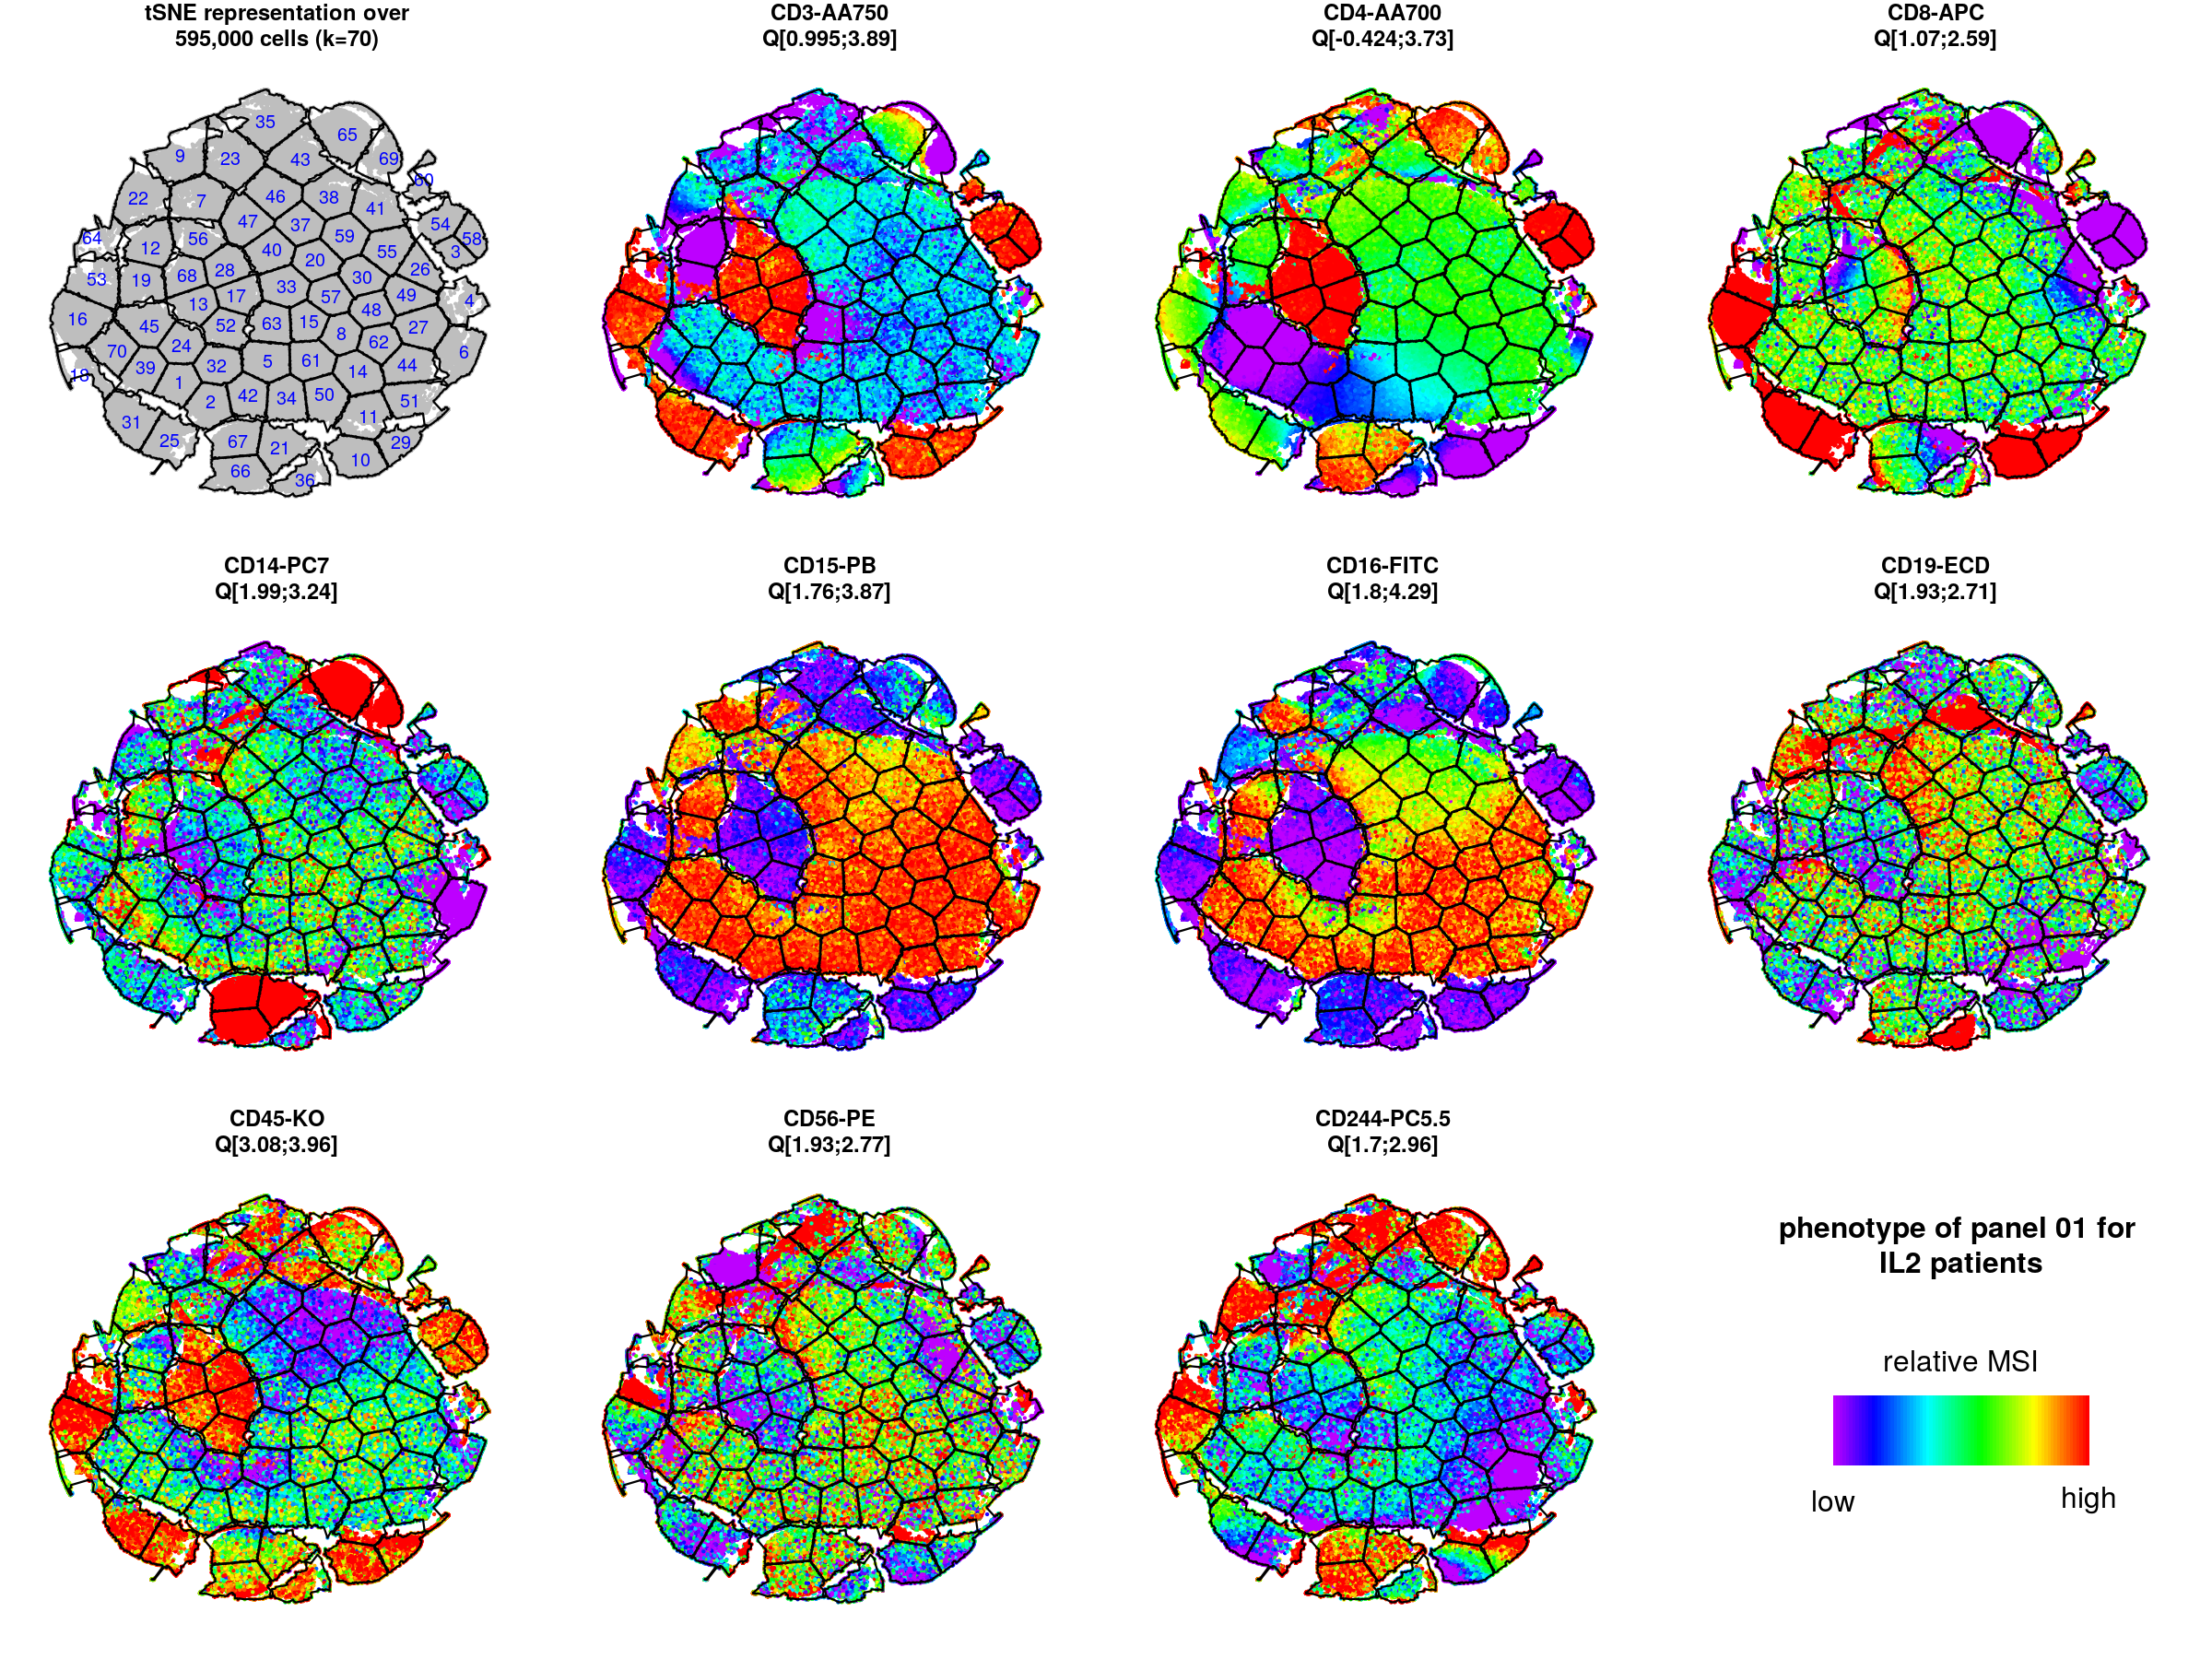
viSNE/kmeans analyses
viSNE plots are generated to determine the phenotypes of identified cell clusters

Slide 26
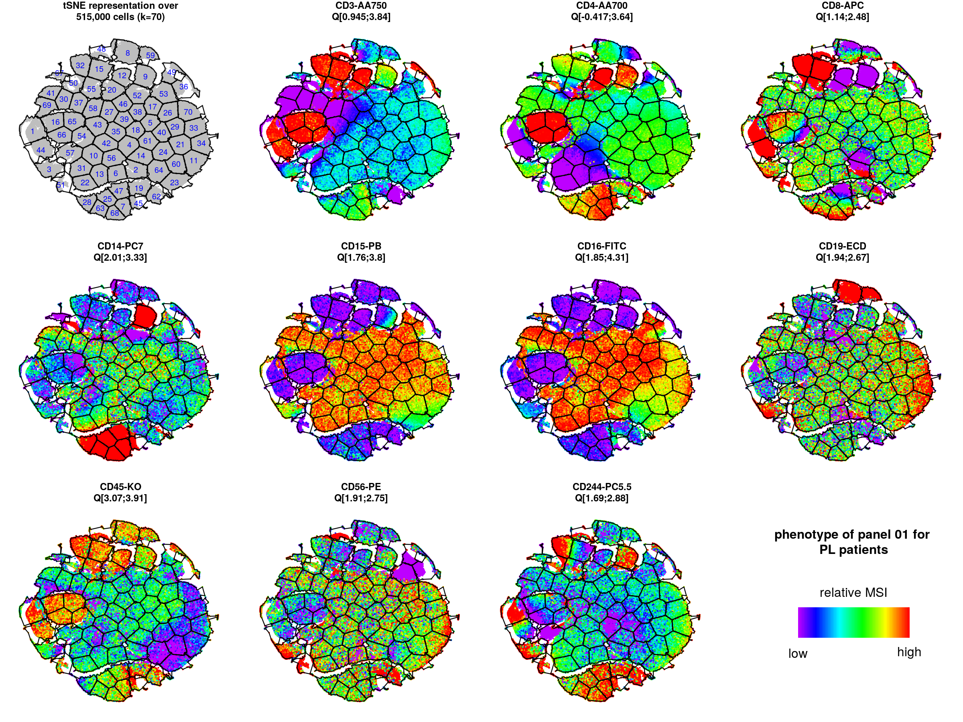
viSNE/kmeans analyses
Panel 01 – numeration cells
tSNE representations for IL2-treated patients
tSNE representations for placebo patients

Slide 27
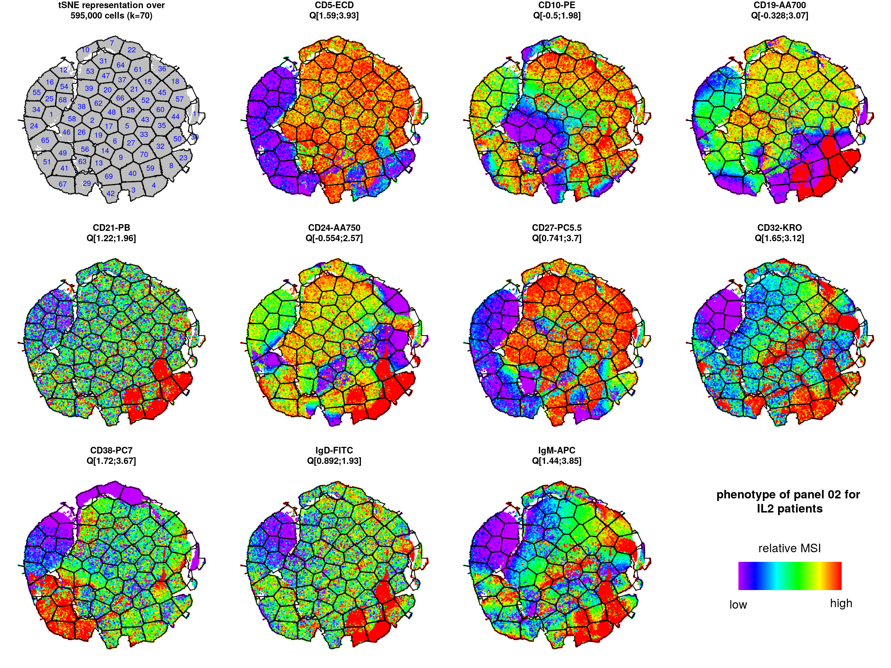
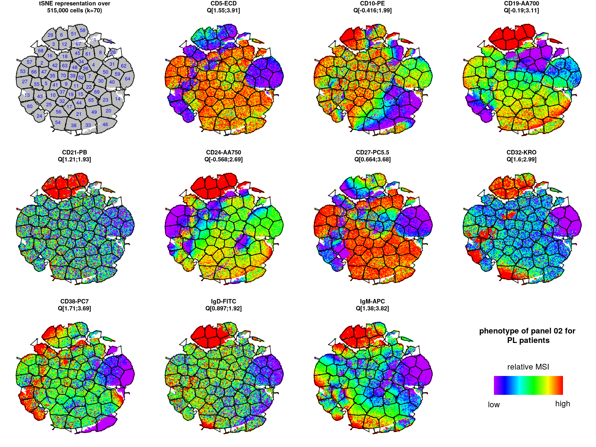
viSNE/kmeans analyses
Panel 02 – B cells
tSNE representations for IL2-treated patients
tSNE representations for placebo patients

Slide 28
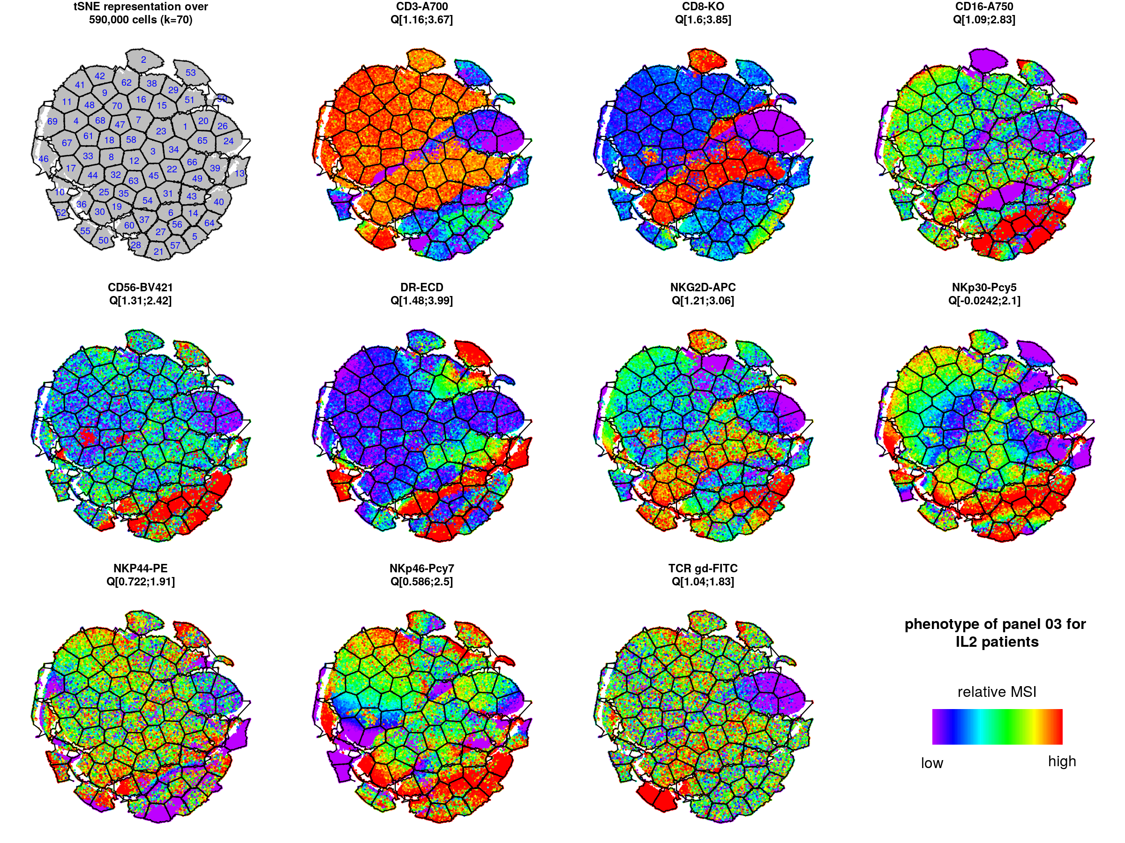
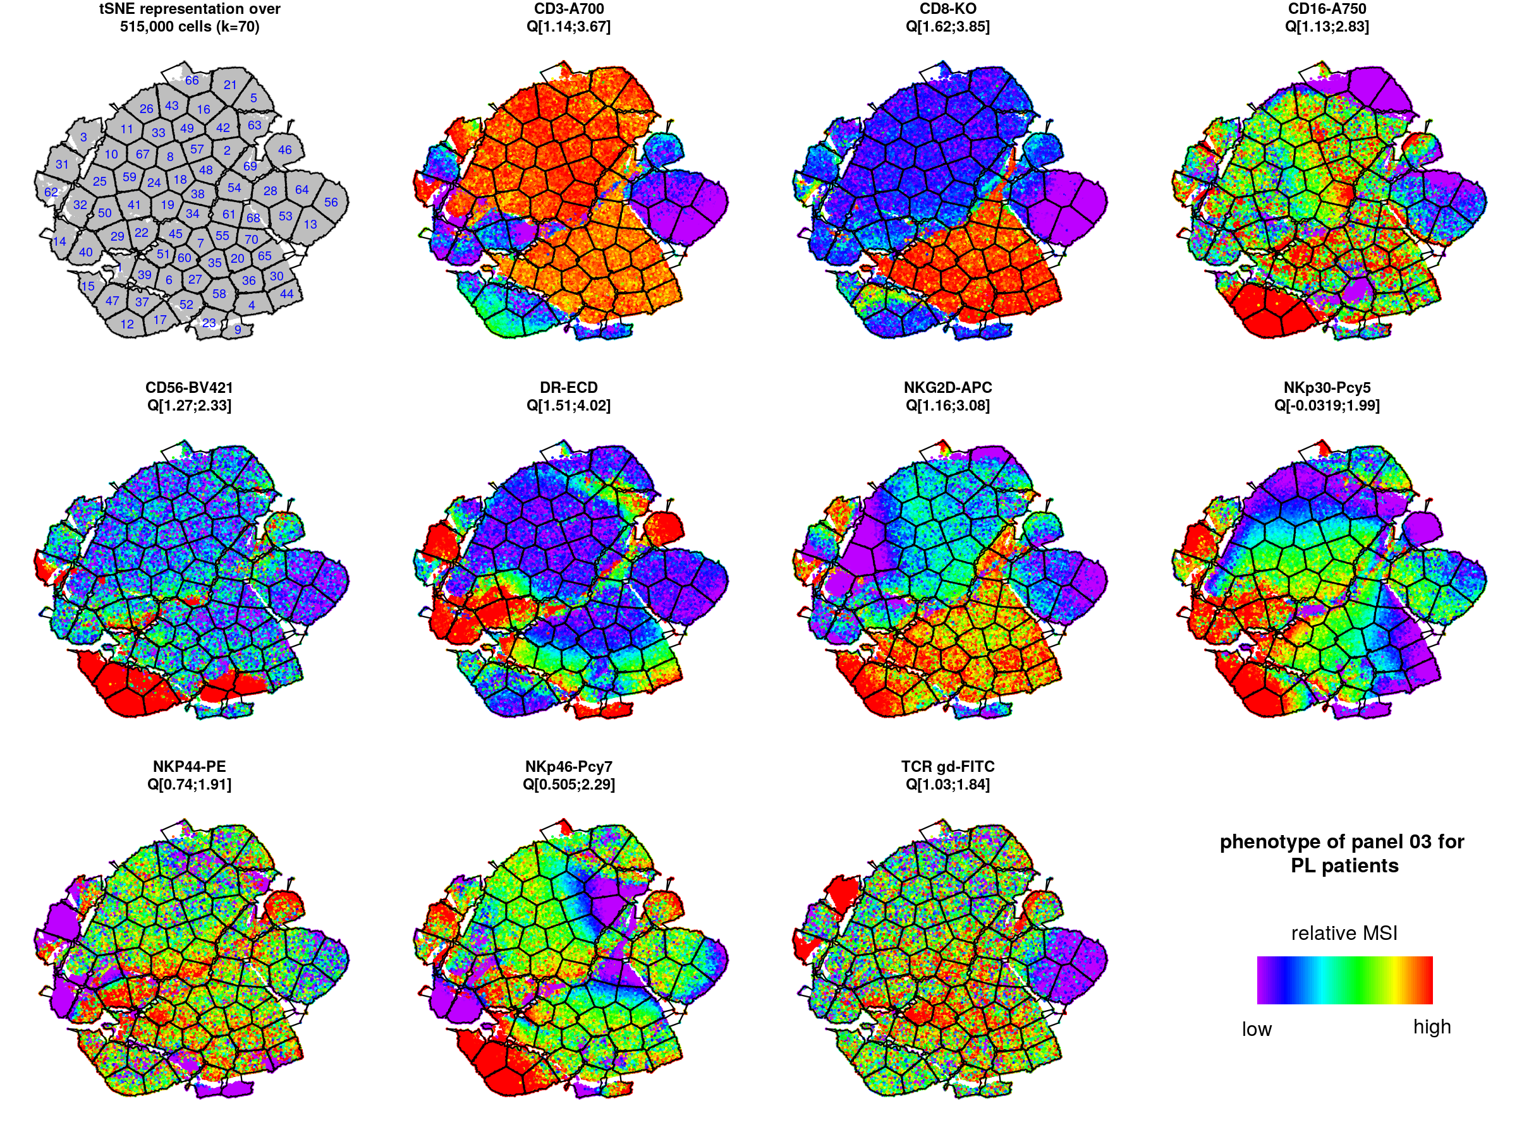
viSNE/kmeans analyses
Panel 03 – NK cells
tSNE representations for IL2-treated patients
tSNE representations for placebo patients

Slide 29
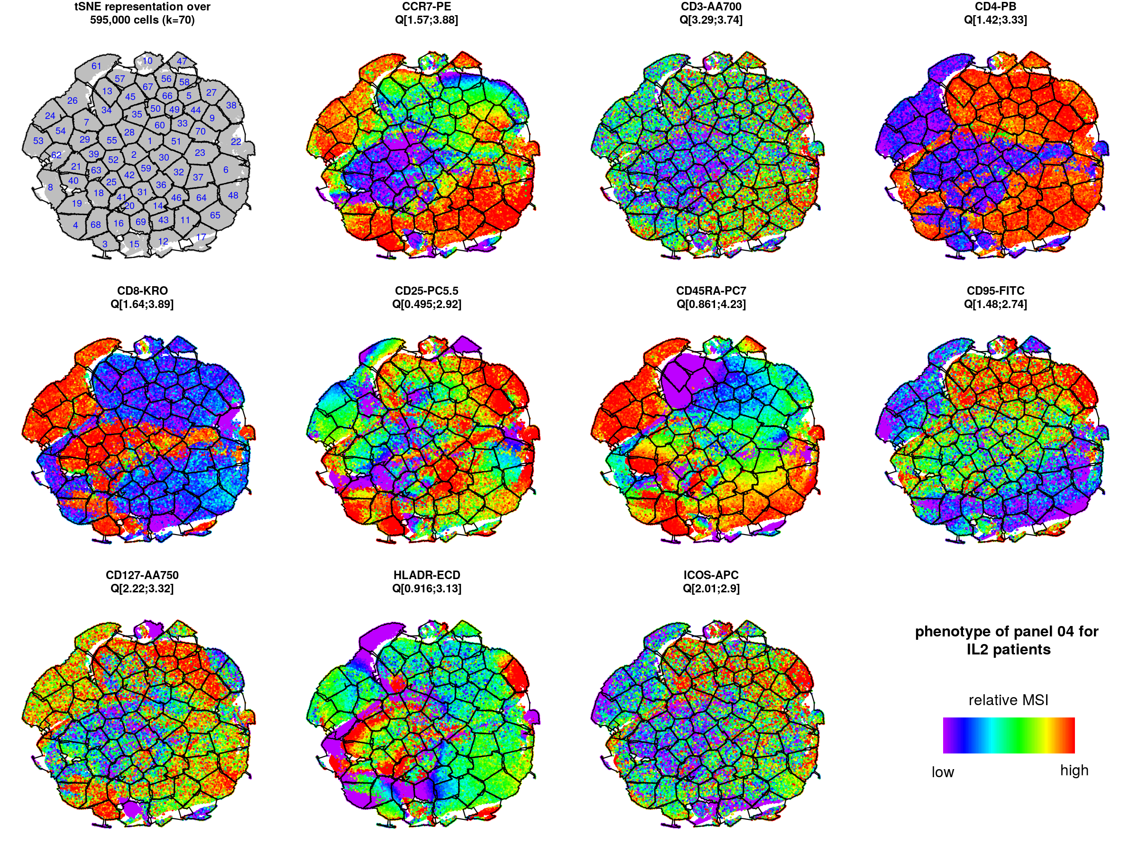
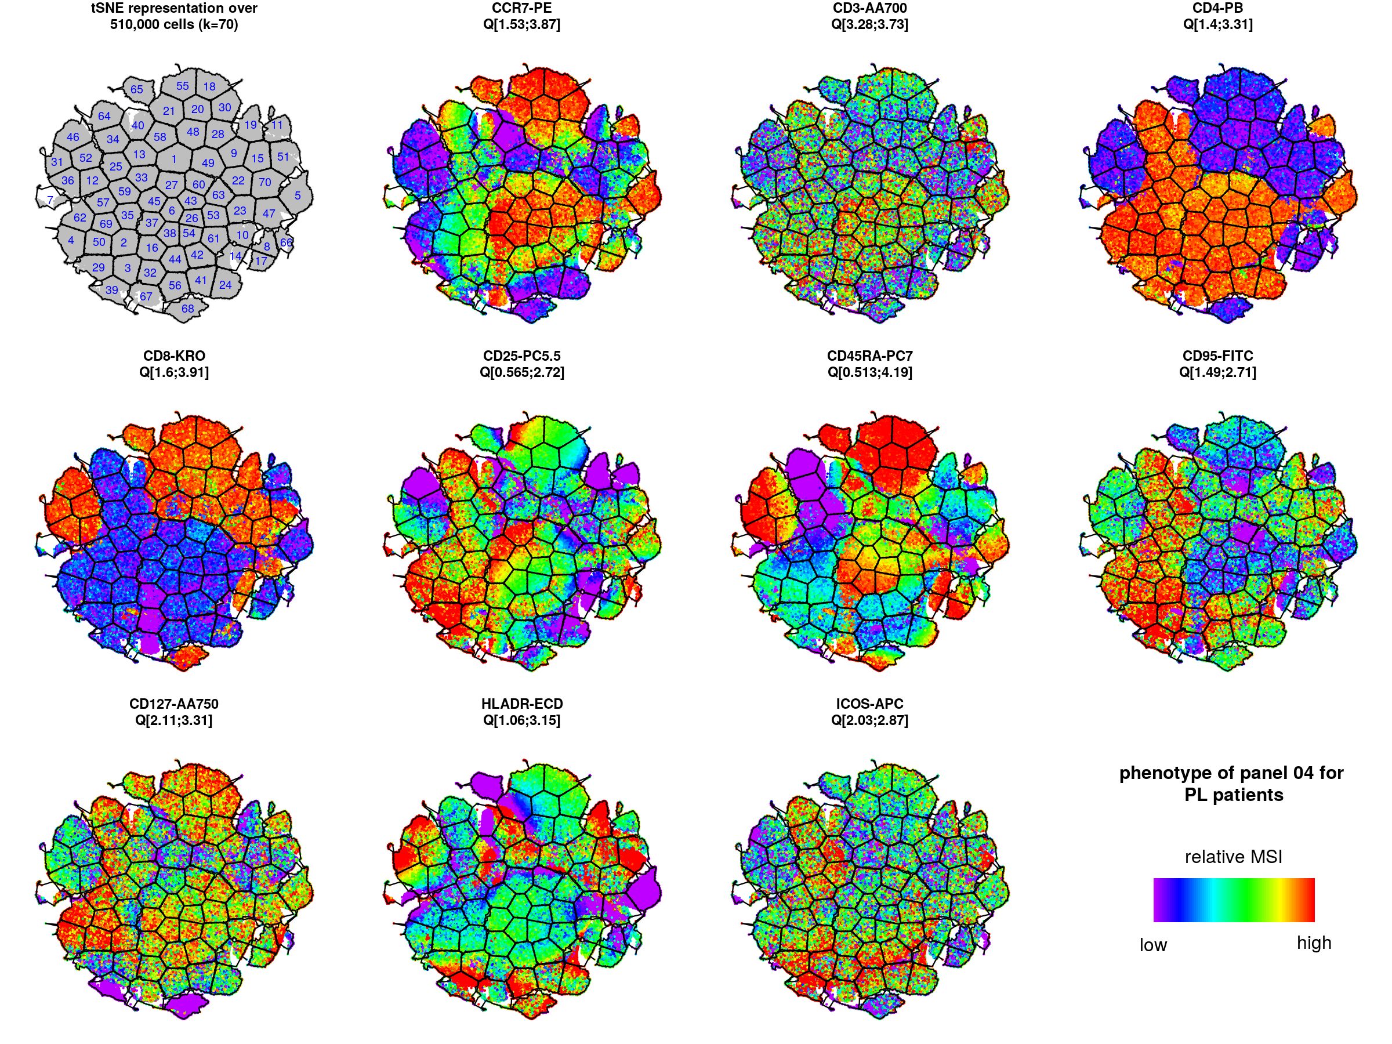
viSNE/kmeans analyses
Panel 04 – Naïve memory T cells
tSNE representations for IL2-treated patients
tSNE representations for placebo patients

Slide 30
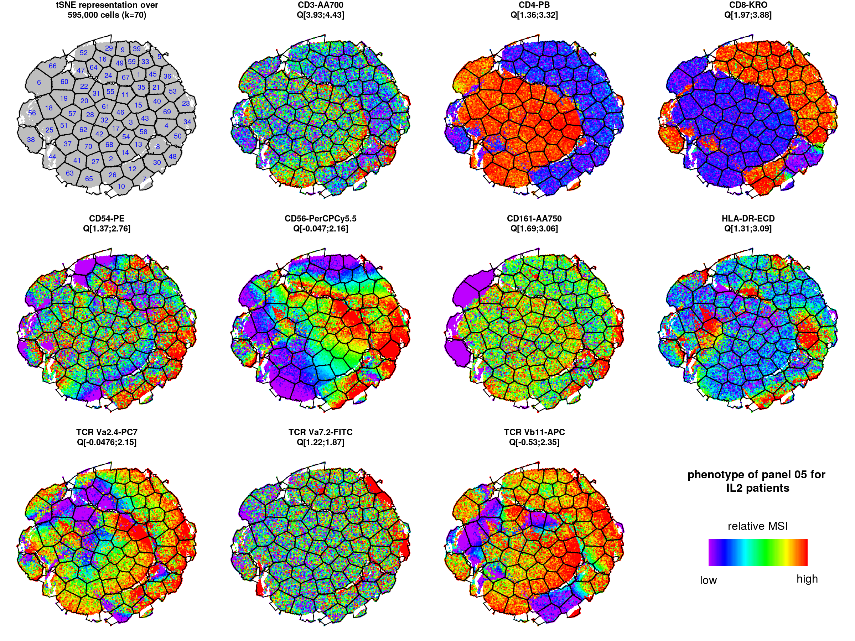
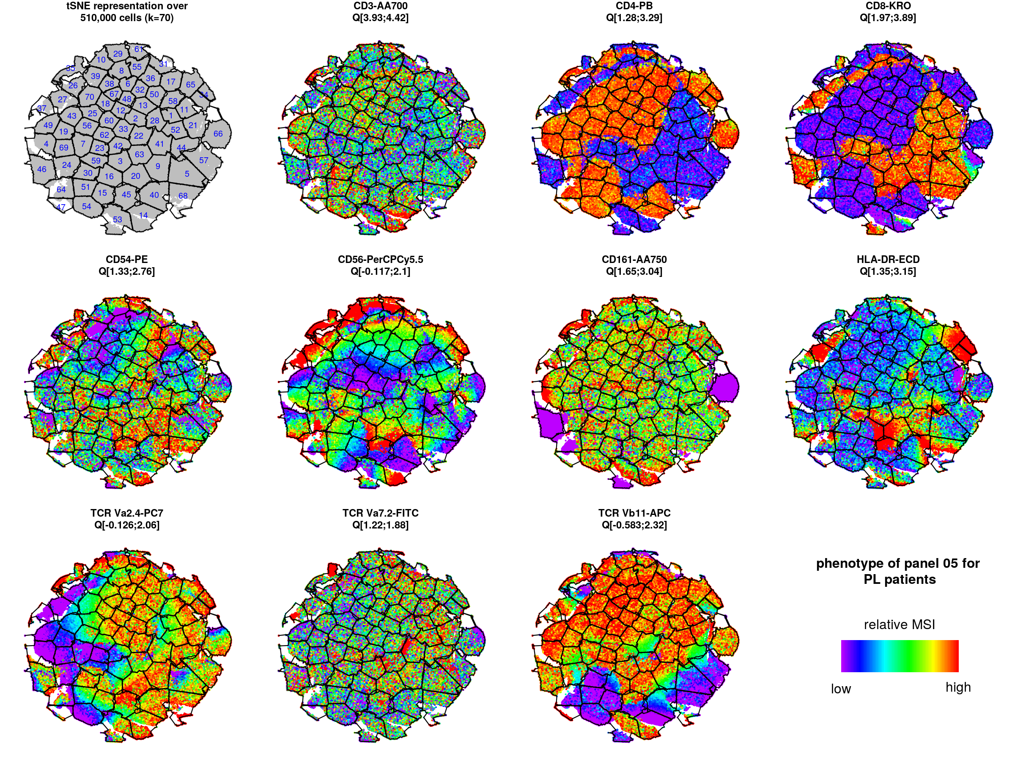
viSNE/kmeans analyses
Panel 05 – NK/MAIT cells
tSNE representations for IL2-treated patients
tSNE representations for placebo patients

Slide 31
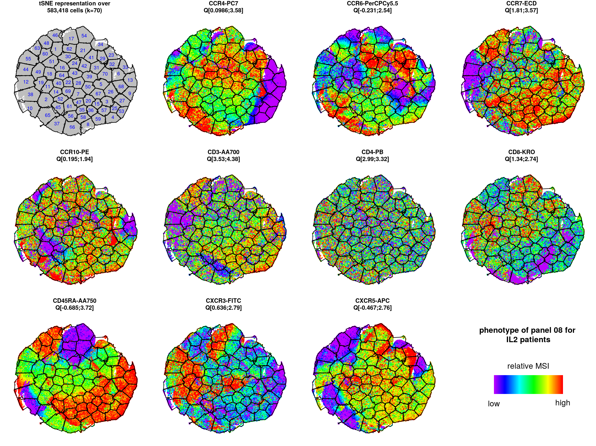
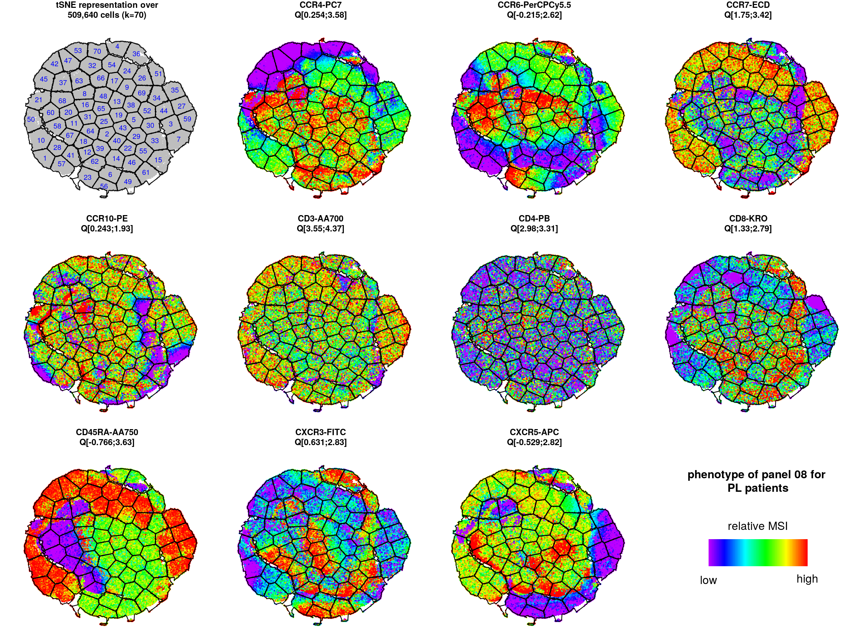
viSNE/kmeans analyses
Panel 08 – T cells polarization
tSNE representations for IL2-treated patients
tSNE representations for placebo patients

Slide 32
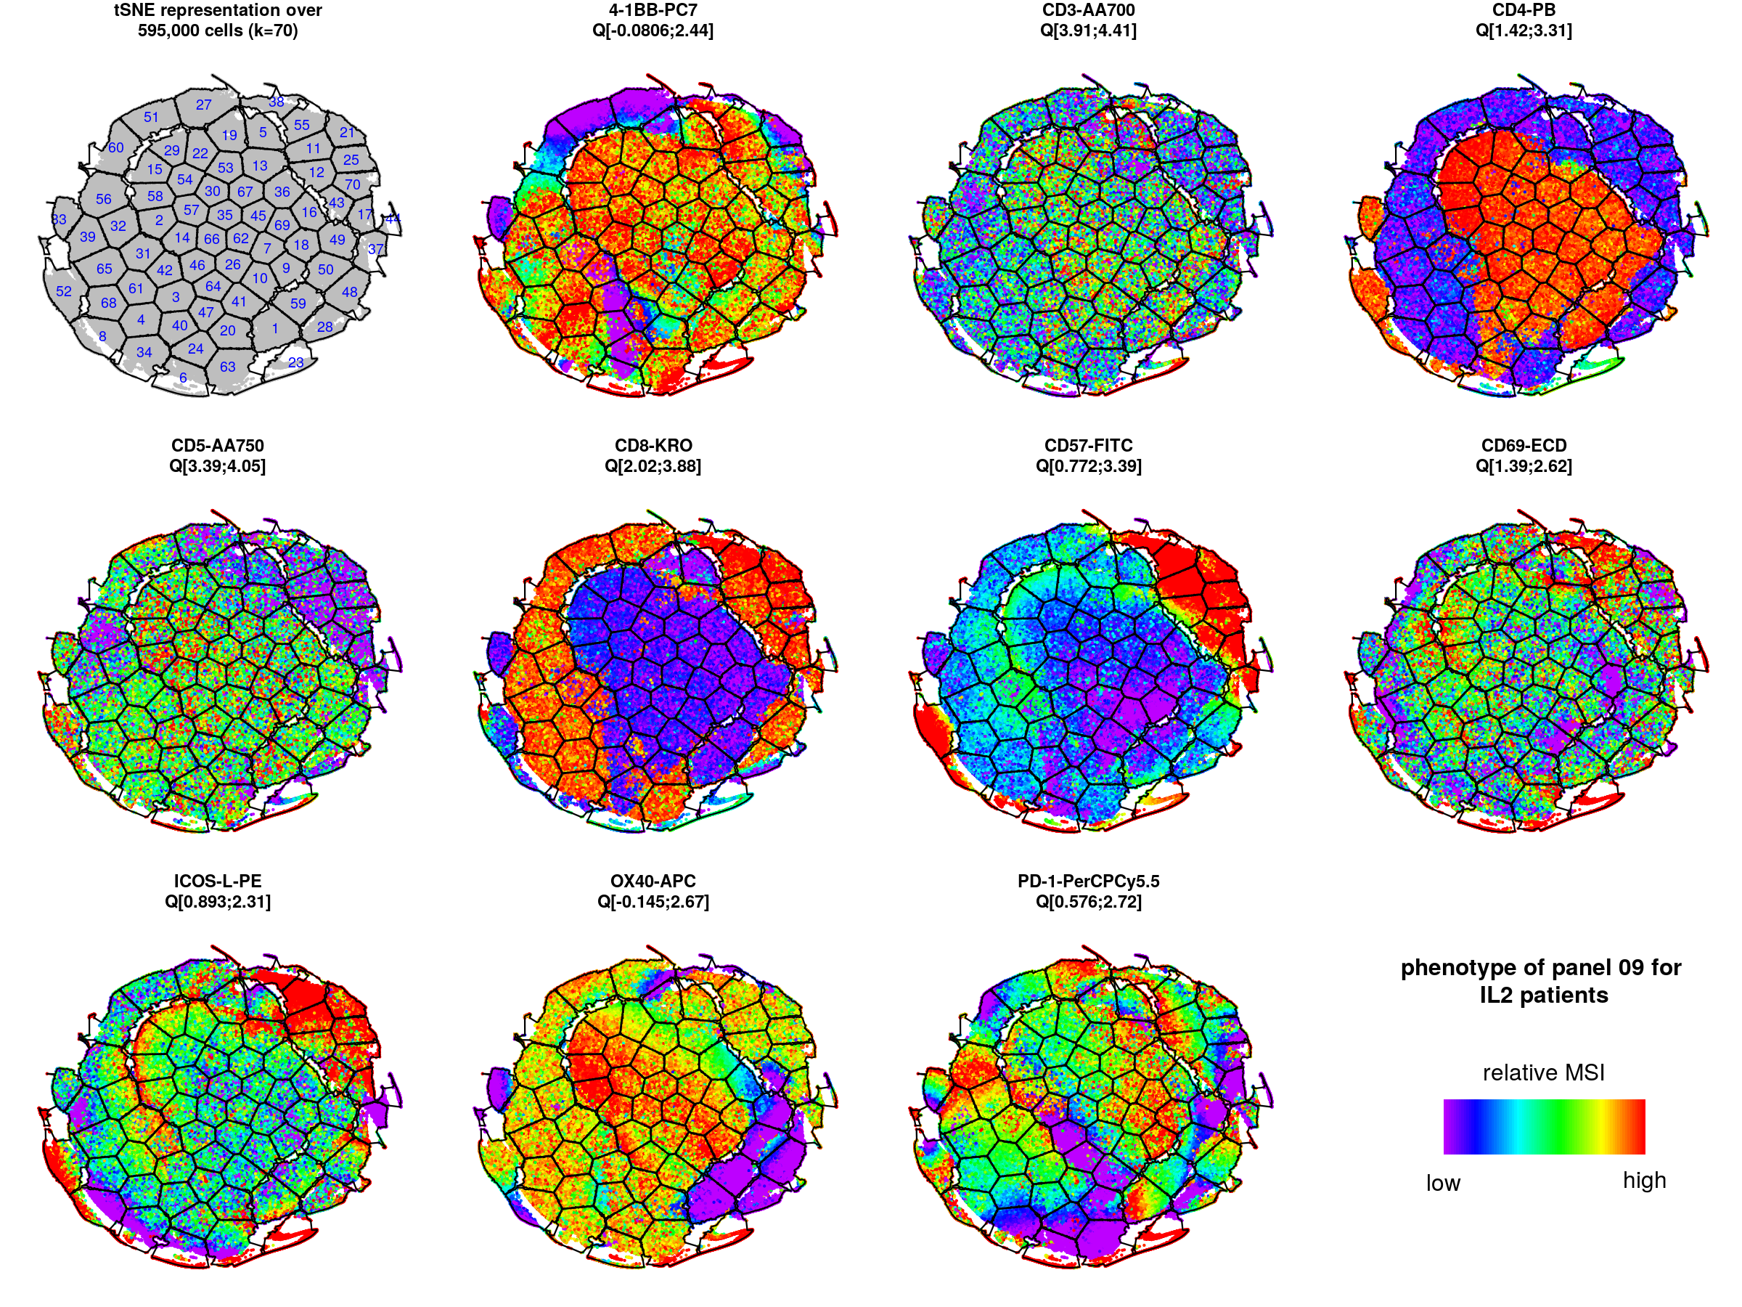
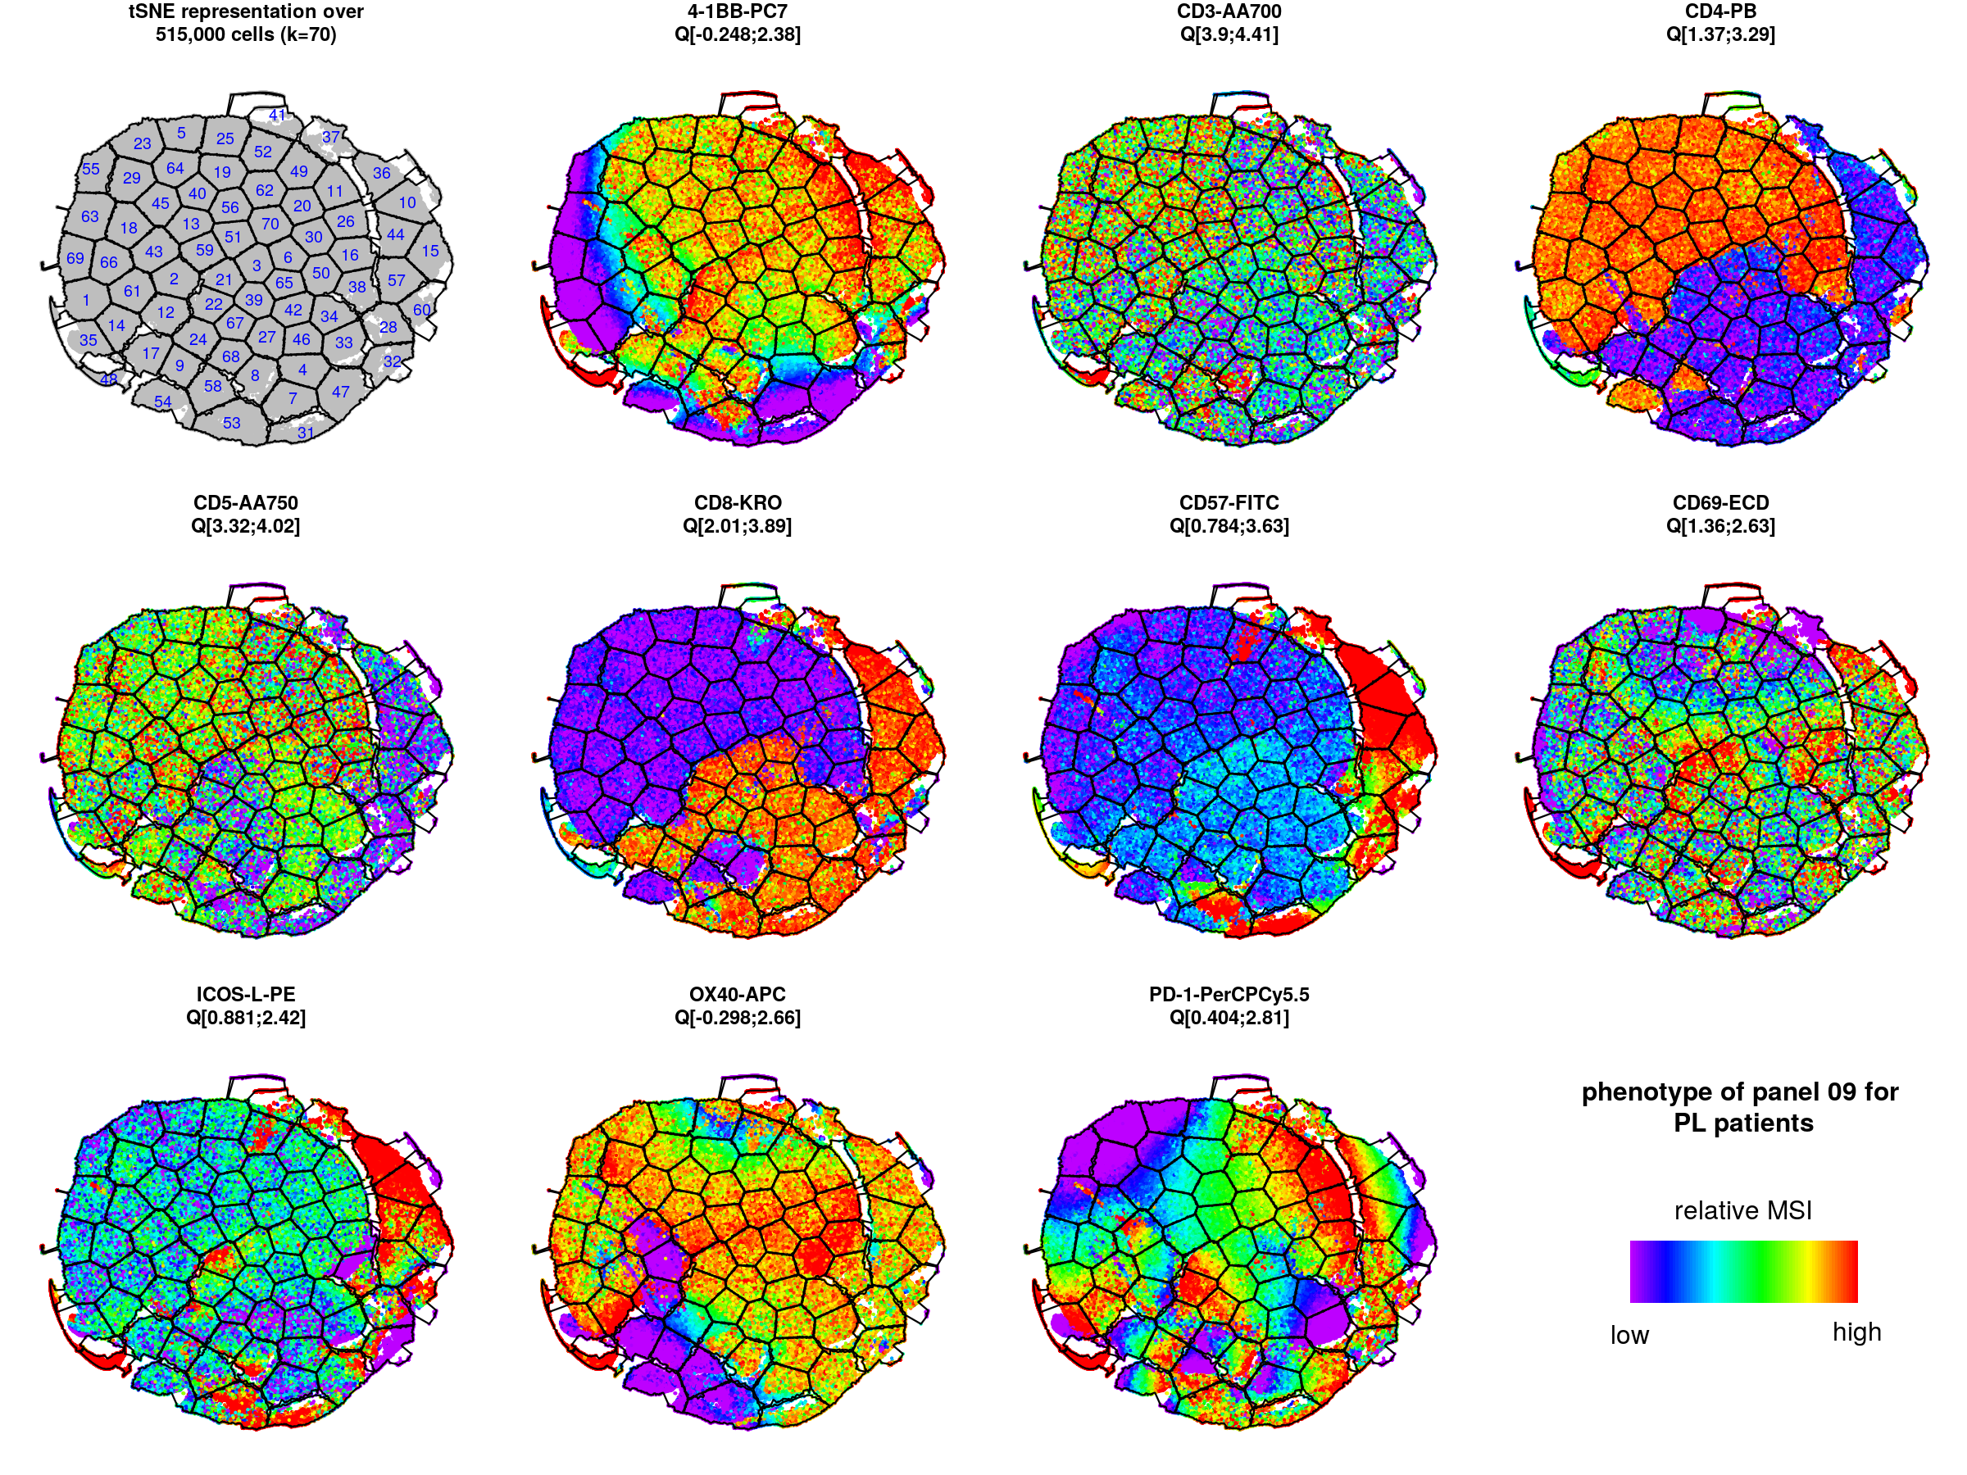
viSNE/kmeans analyses
Panel 09 – T cells activation
tSNE representations for IL2-treated patients
tSNE representations for placebo patients

Slide 33
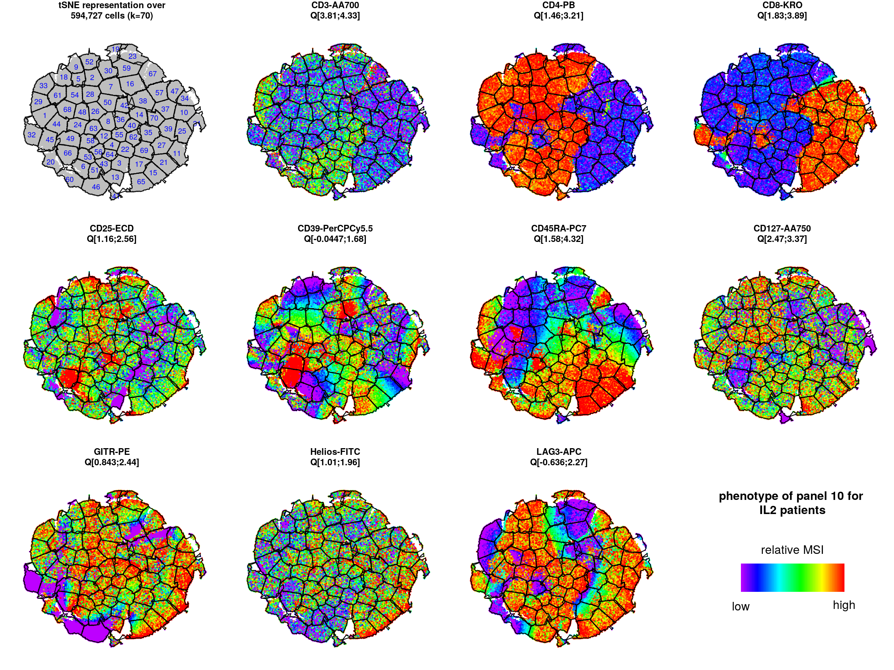
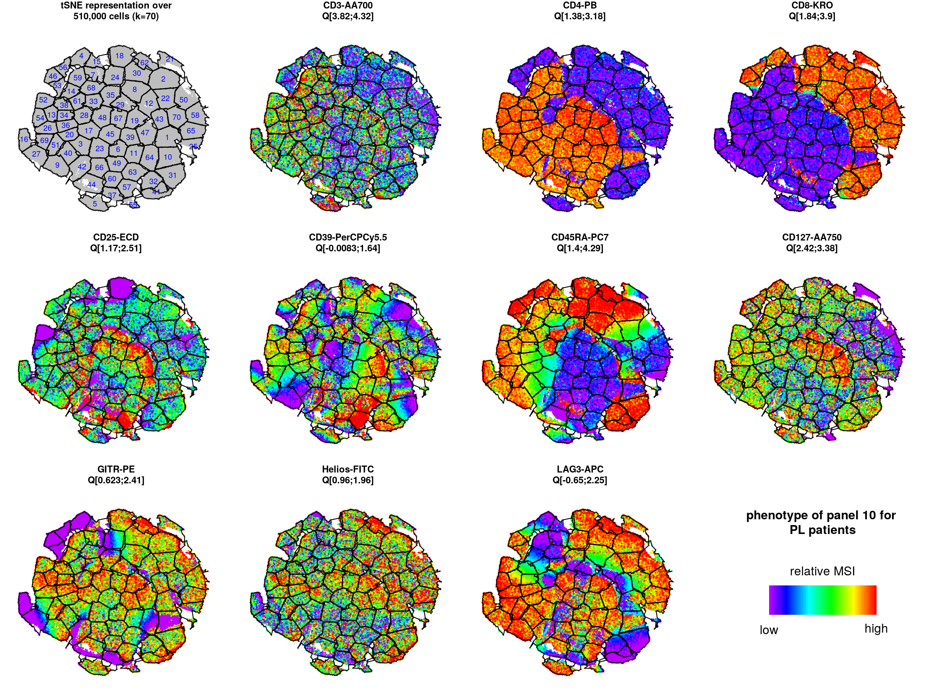
viSNE/kmeans analyses
Panel 10 – Regulatory T cells (function)
tSNE representations for IL2-treated patients
tSNE representations for placebo patients

Slide 34
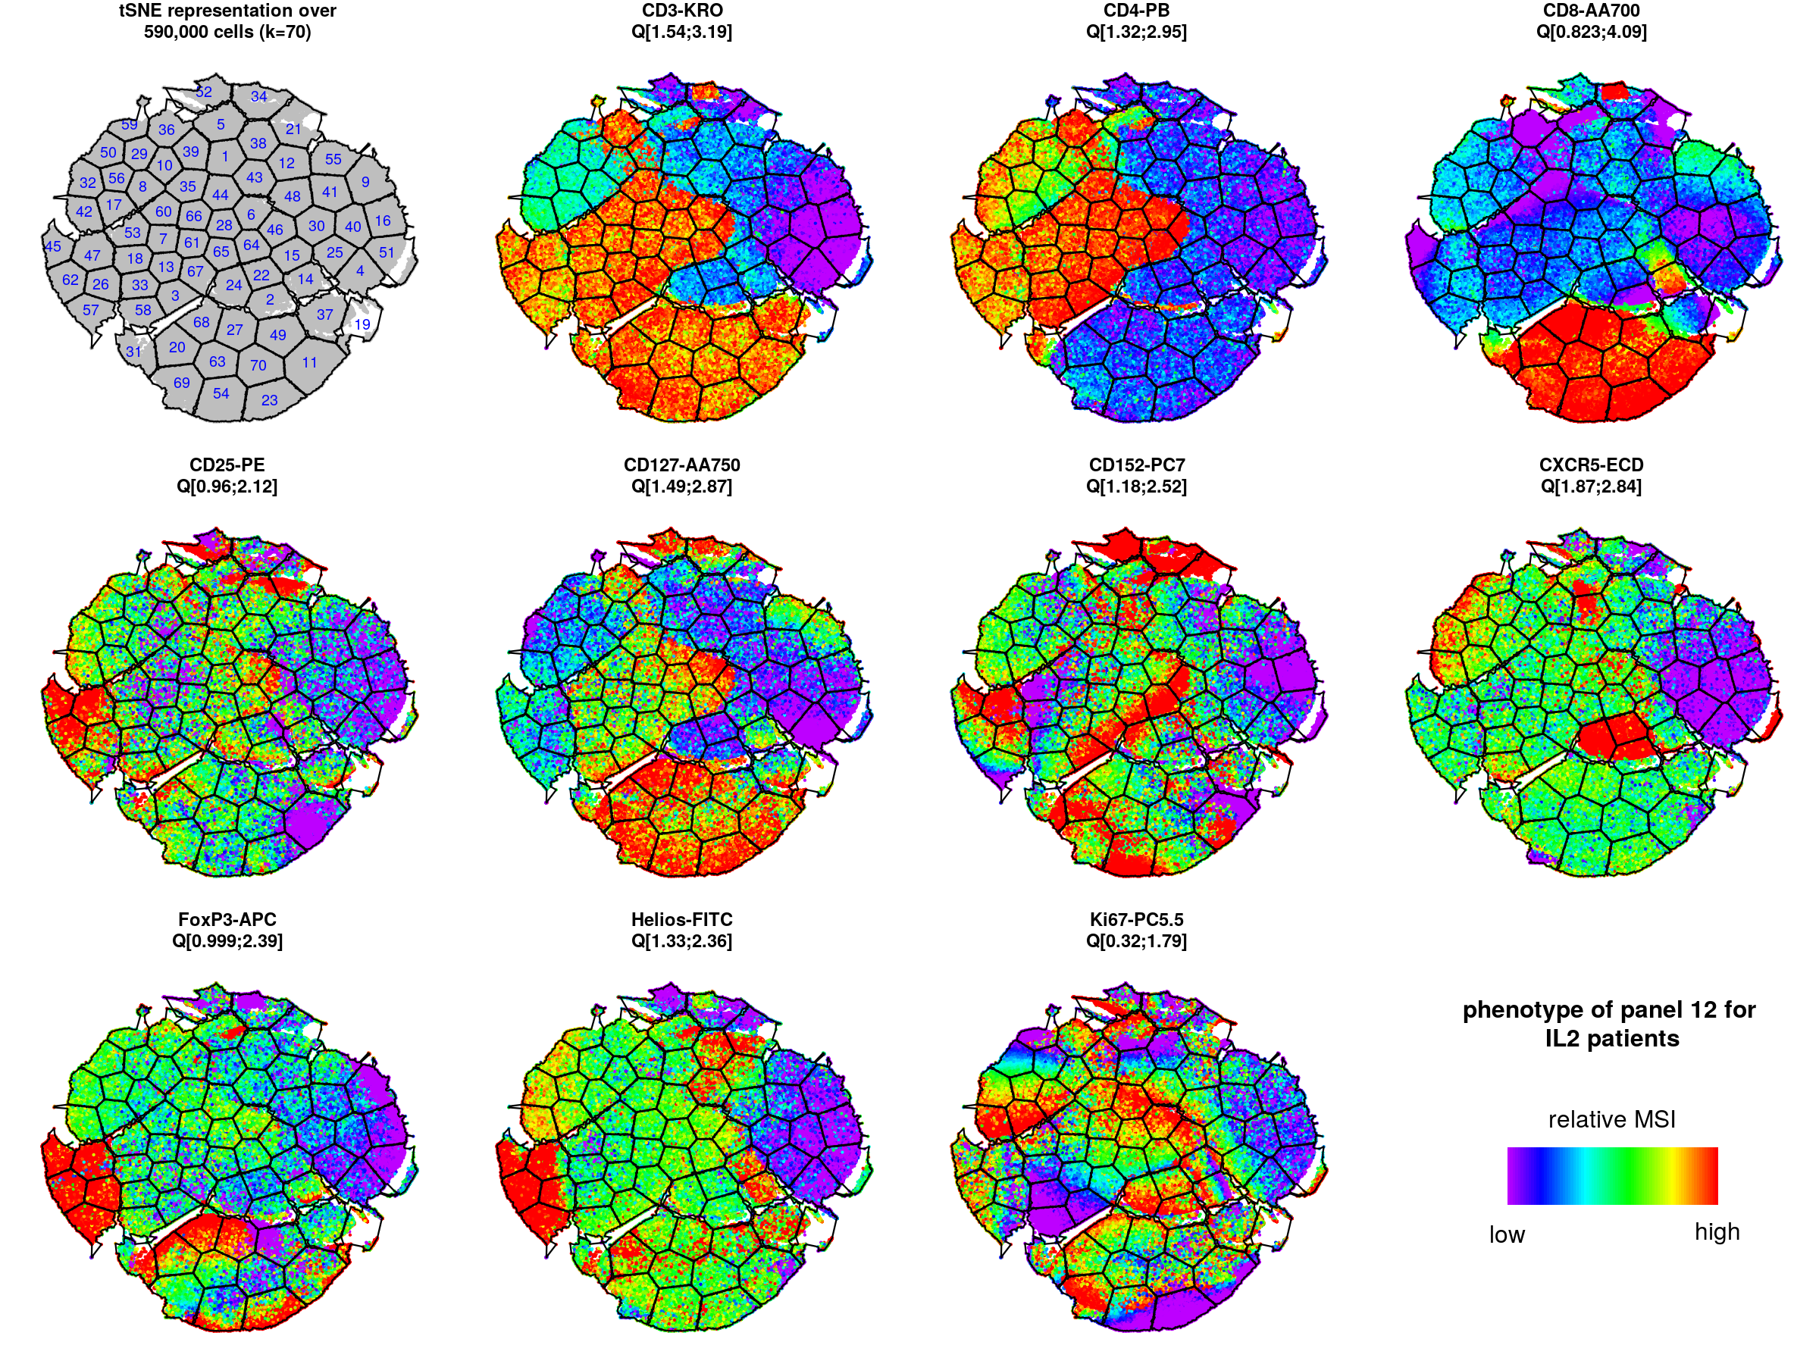
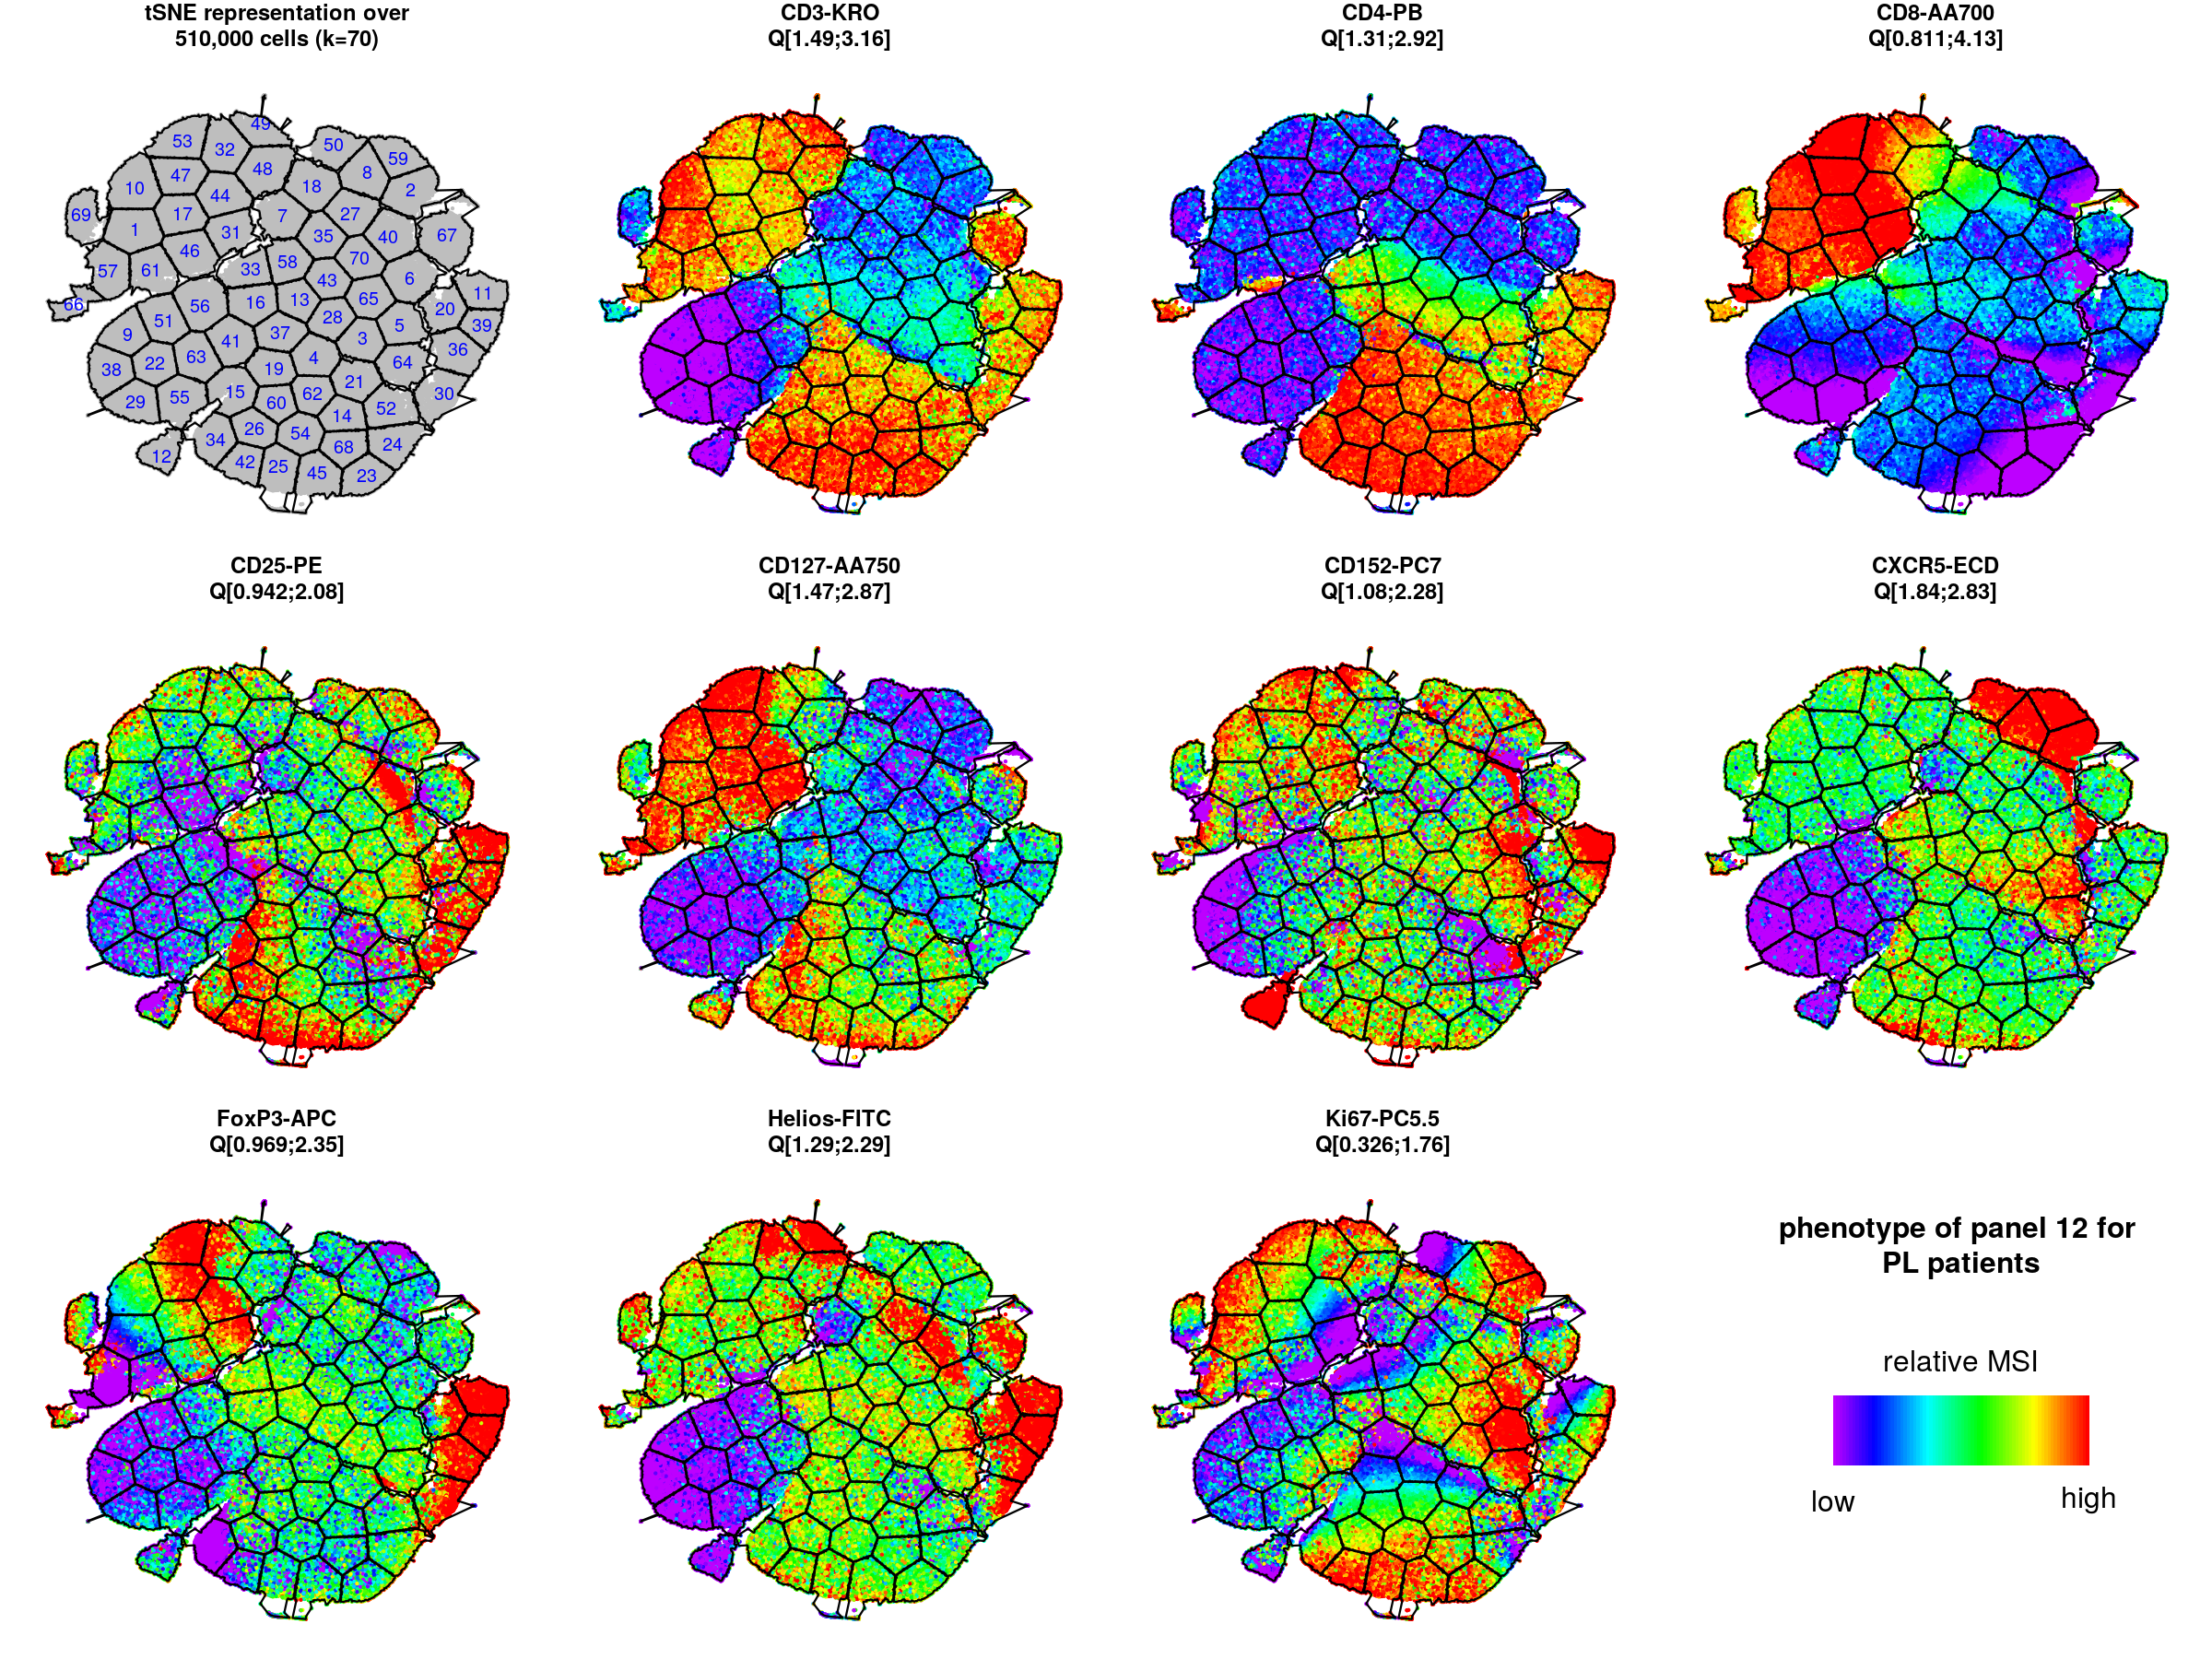
viSNE/kmeans analyses
Panel 12 – Regulatory T cells
tSNE representations for IL2-treated patients
tSNE representations for placebo patients

Slide 35
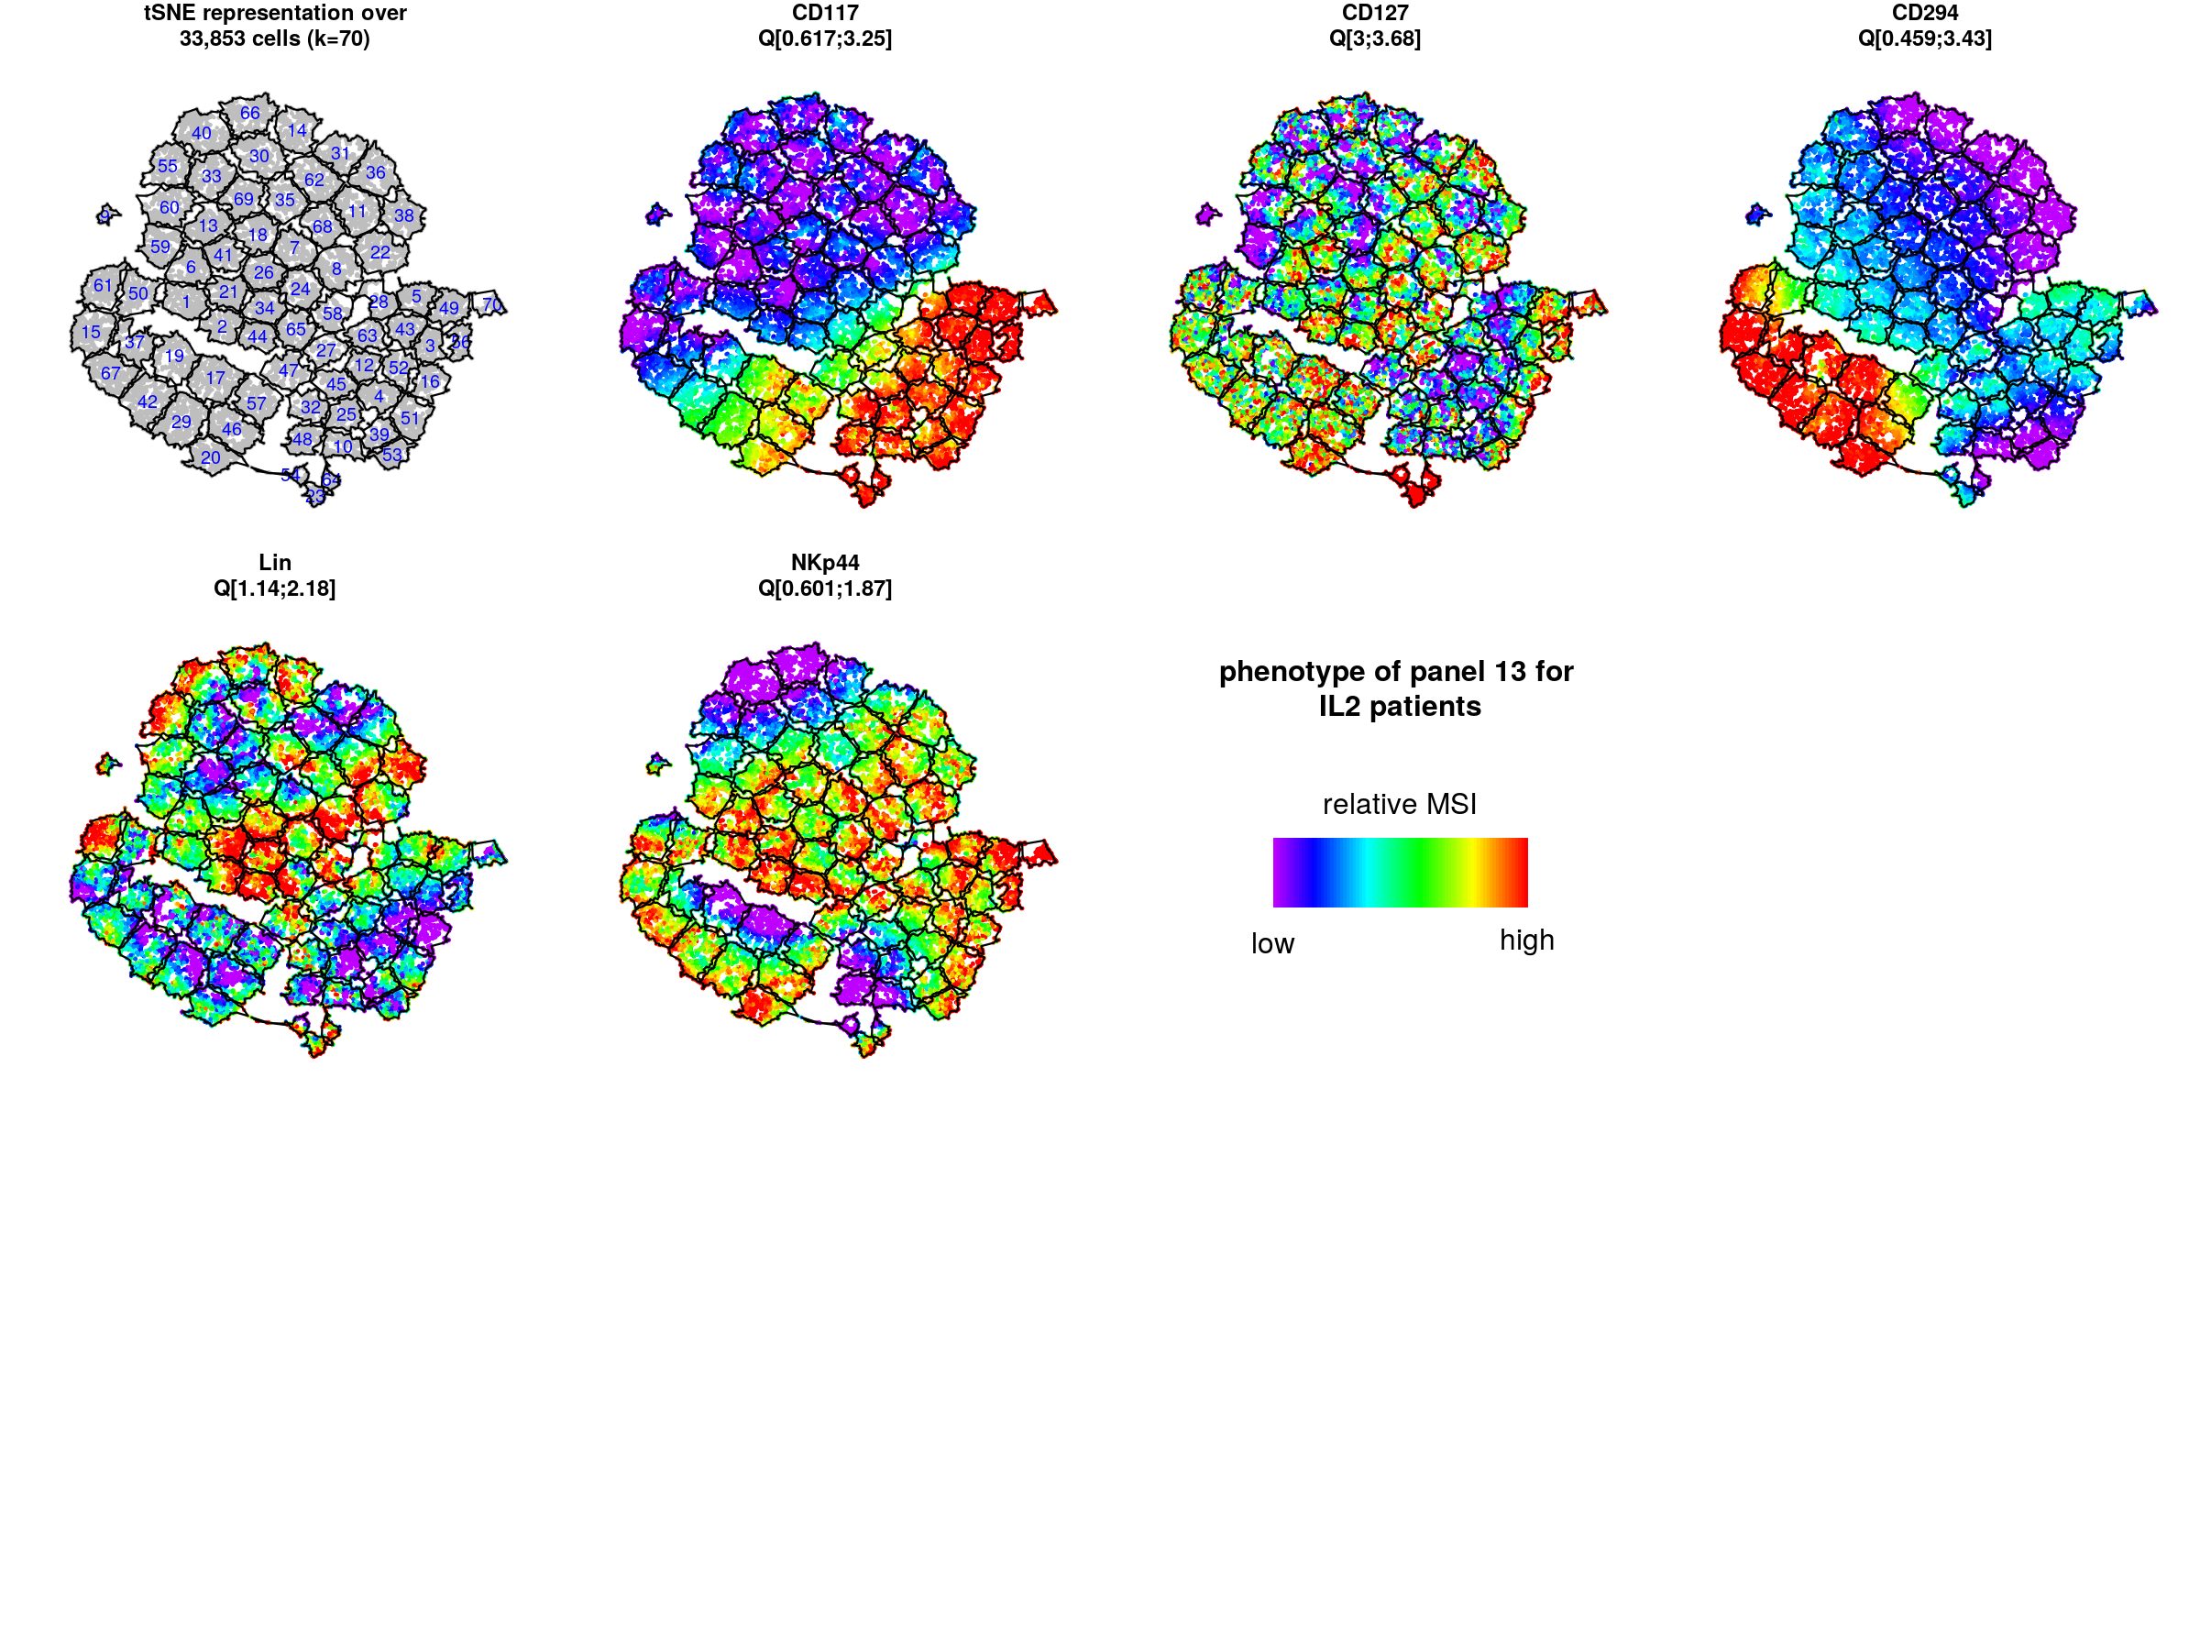
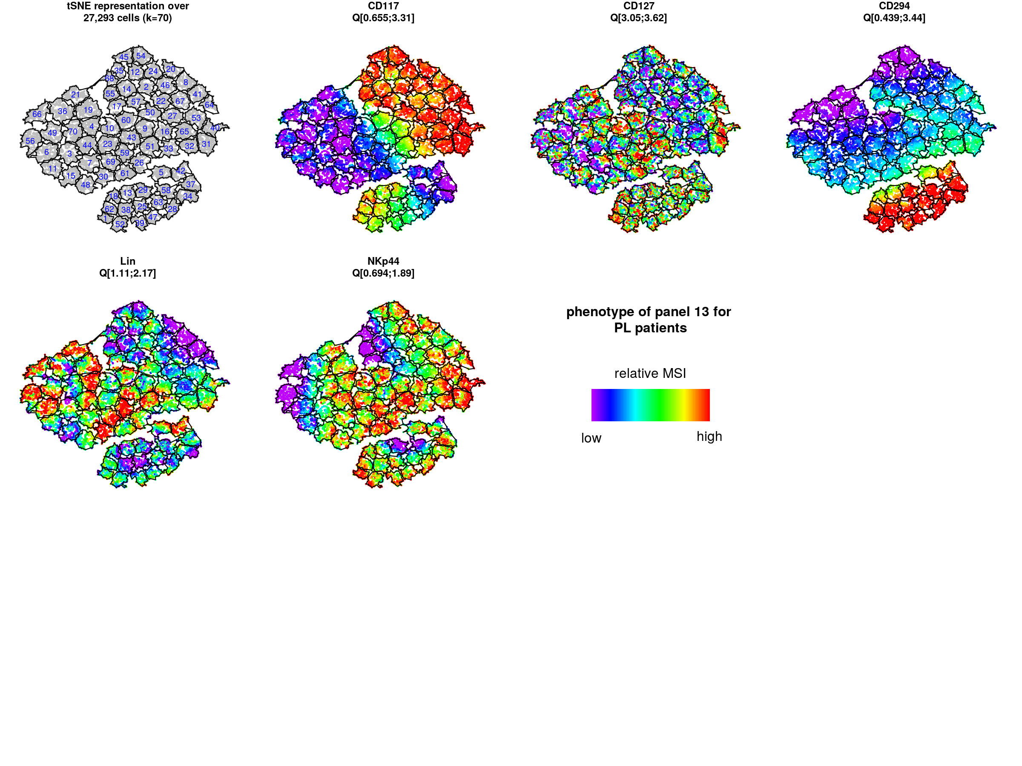
viSNE/kmeans analyses
Panel 13 – Innate Lymphoid Cells
tSNE representations for IL2-treated patients
tSNE representations for placebo patients

Slide 36
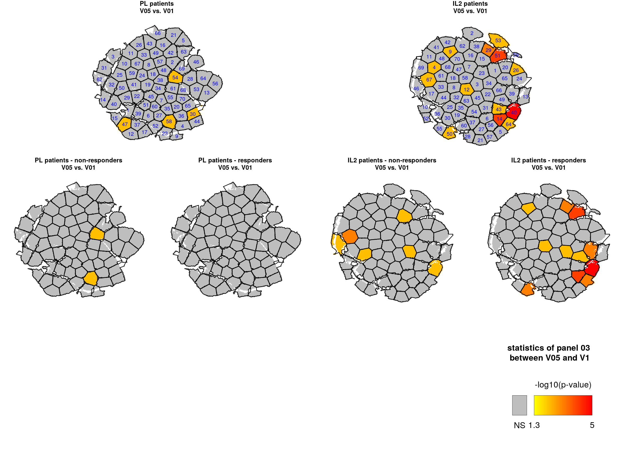
viSNE/kmeans analyses
Univariate analyses (Wilcoxon signed rank test) are performed to identify cell populations impacted by treatments at each timepoint
Cell clusters on the tSNE representations are colored based on their p-values using a gradient scale
Panel 03 – NK cells
V05 vs. V01

Slide 37
viSNE/kmeans analyses
Univariate analyses (Wilcoxon signed rank test) are performed to identify cell populations impacted by treatments at each timepoint
Cell clusters on the tSNE representations are colored based on their p-values using a gradient scale
Univariate analyses are also performed separately for responders and non-responders
Panel 03 – NK cells
V05 vs. V01

Slide 38
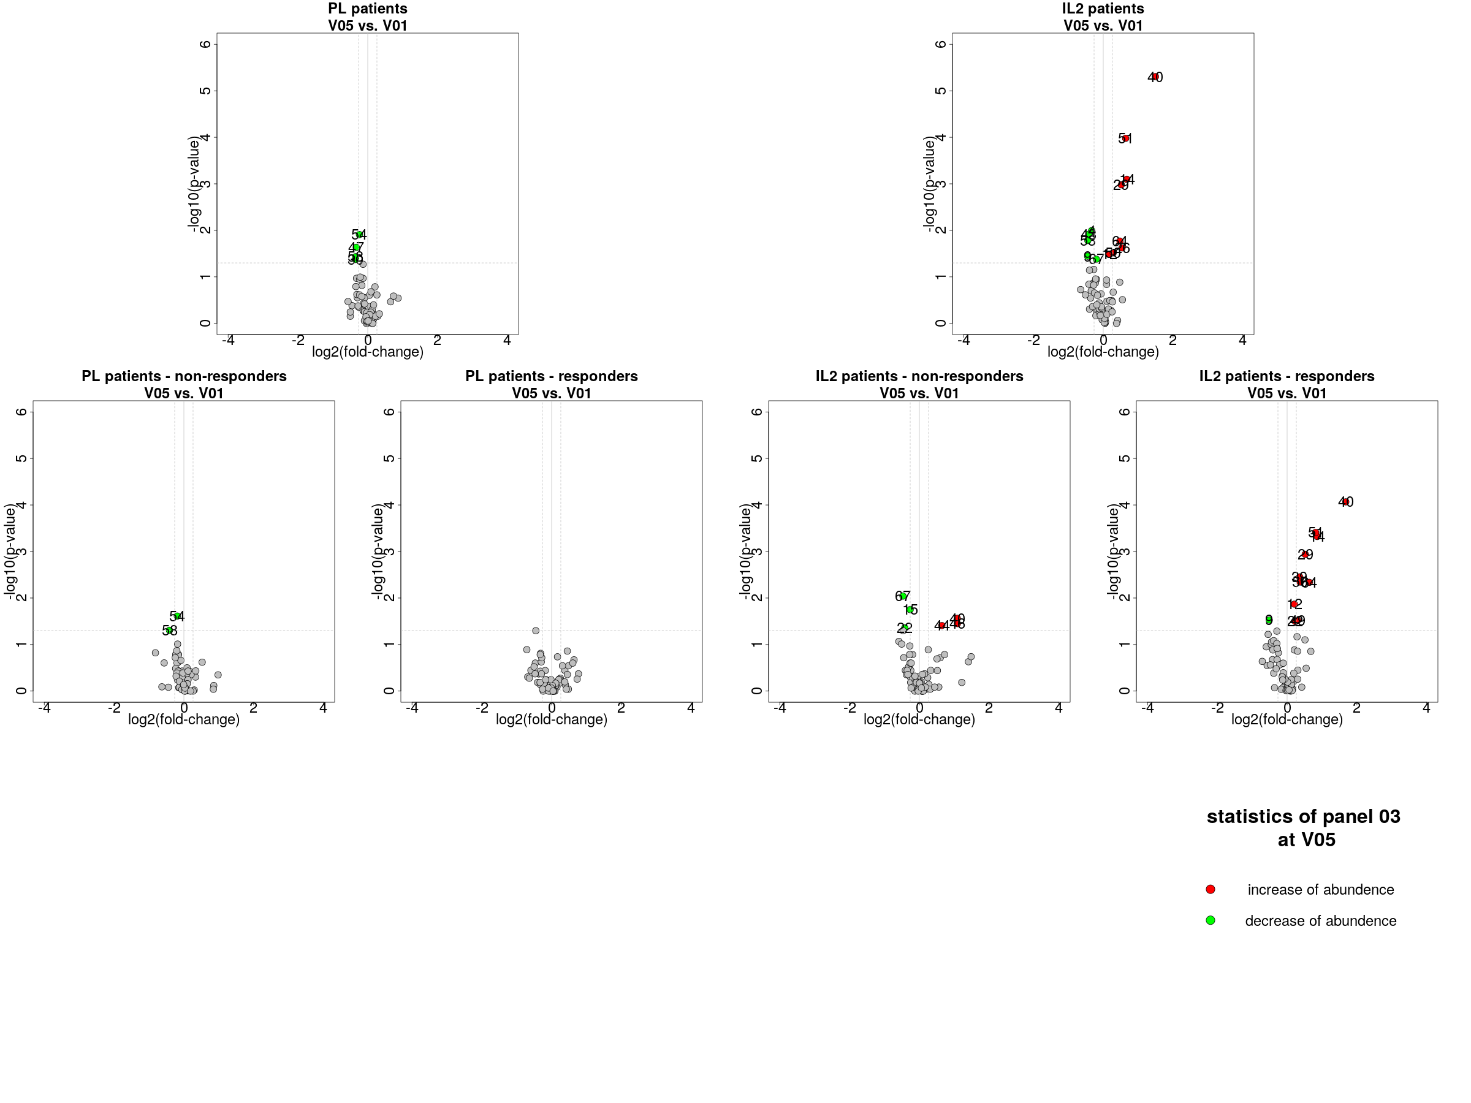
viSNE/kmeans analyses
Univariate analyses (Wilcoxon signed rank test) are performed to identify cell populations impacted by treatments at each timepoint
Cell clusters on the tSNE representations are colored based on their p-values using a gradient scale
Univariate analyses are also performed separately for responders and non-responders
Volcano plot representations are also created to visualize the directionally of cluster abundance changes
Panel 03 – NK cells
V05 vs. V01

Slide 39
viSNE/kmeans analyses
This analytical pipeline can be used to identify cell populations impacted by the IL2 treatment and distinguishing responders vs. non-responders
Clusters 51-29 → uncharacterized CD4⁺
Clusters 40-14-64 → activated NK cells (NKp46⁺/NKp30⁺/NKG2D⁺)
Cluster 50 → TCRγδ⁺
Panel 03 – NK cells
V05 vs. V01

Slide 40
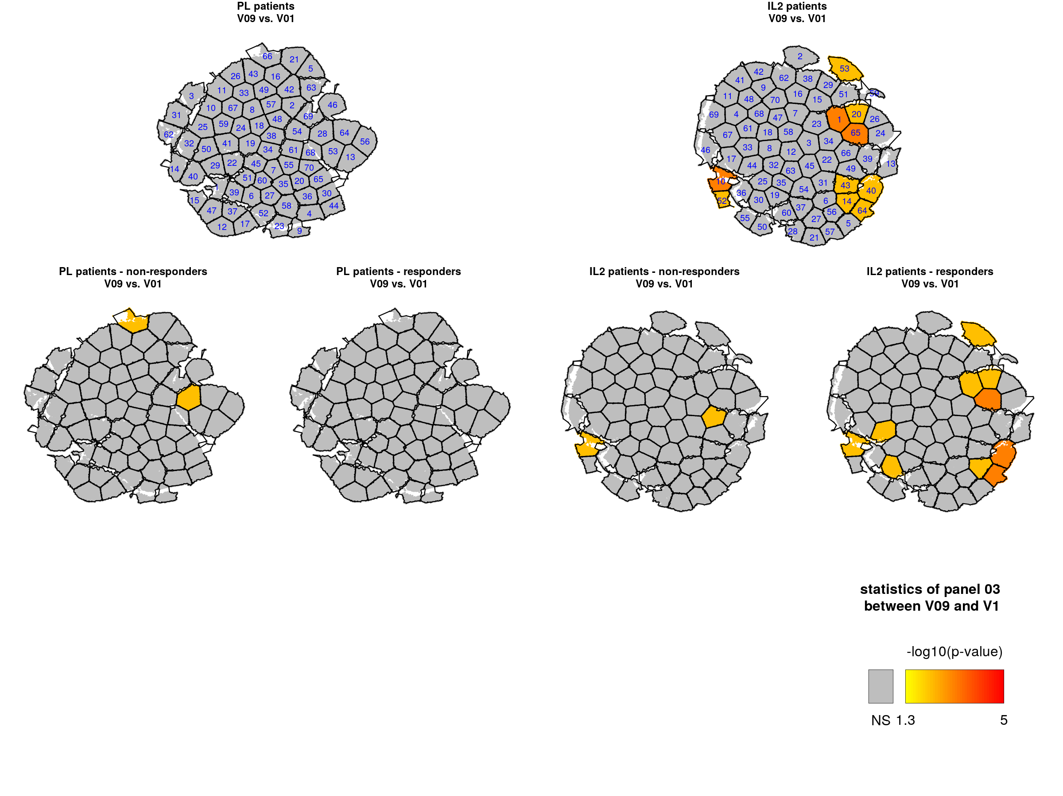
viSNE/kmeans analyses
This analytical pipeline can be used to study the change of cell cluster abundances over time
Panel 03 – NK cells
V09 vs. V01

Slide 41
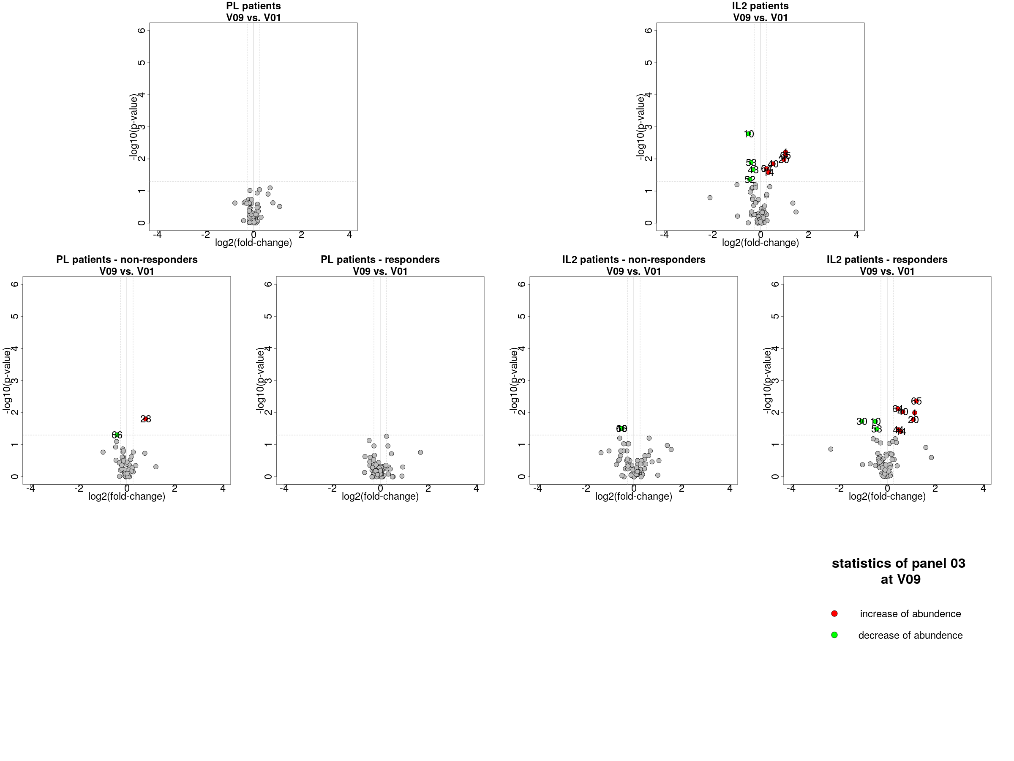
viSNE/kmeans analyses
This analytical pipeline can be used to study the change of cell cluster abundances over time
Panel 03 – NK cells
V09 vs. V01

Slide 42
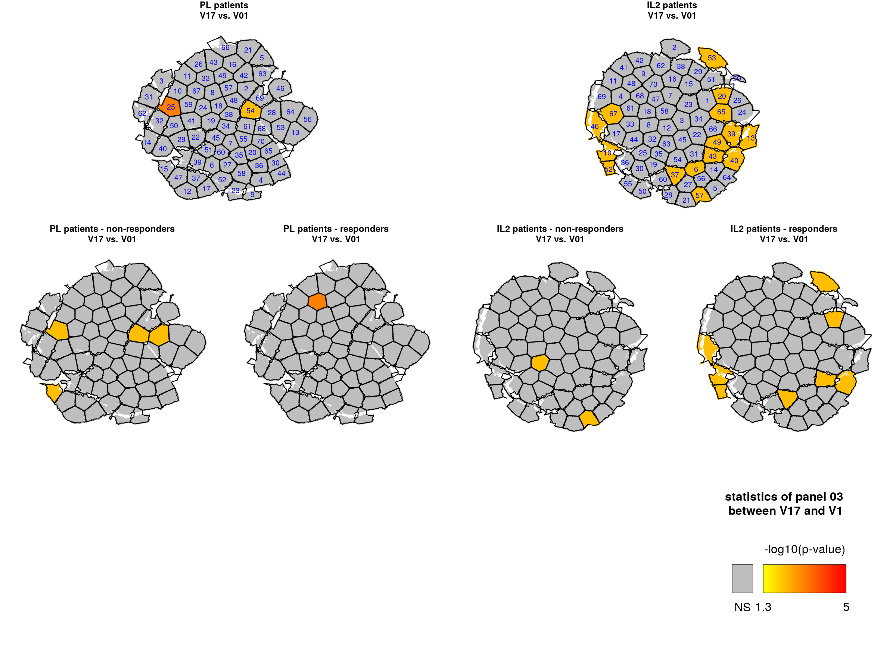
viSNE/kmeans analyses
This analytical pipeline can be used to study the change of cell cluster abundances over time
Panel 03 – NK cells
V17 vs. V01

Slide 43
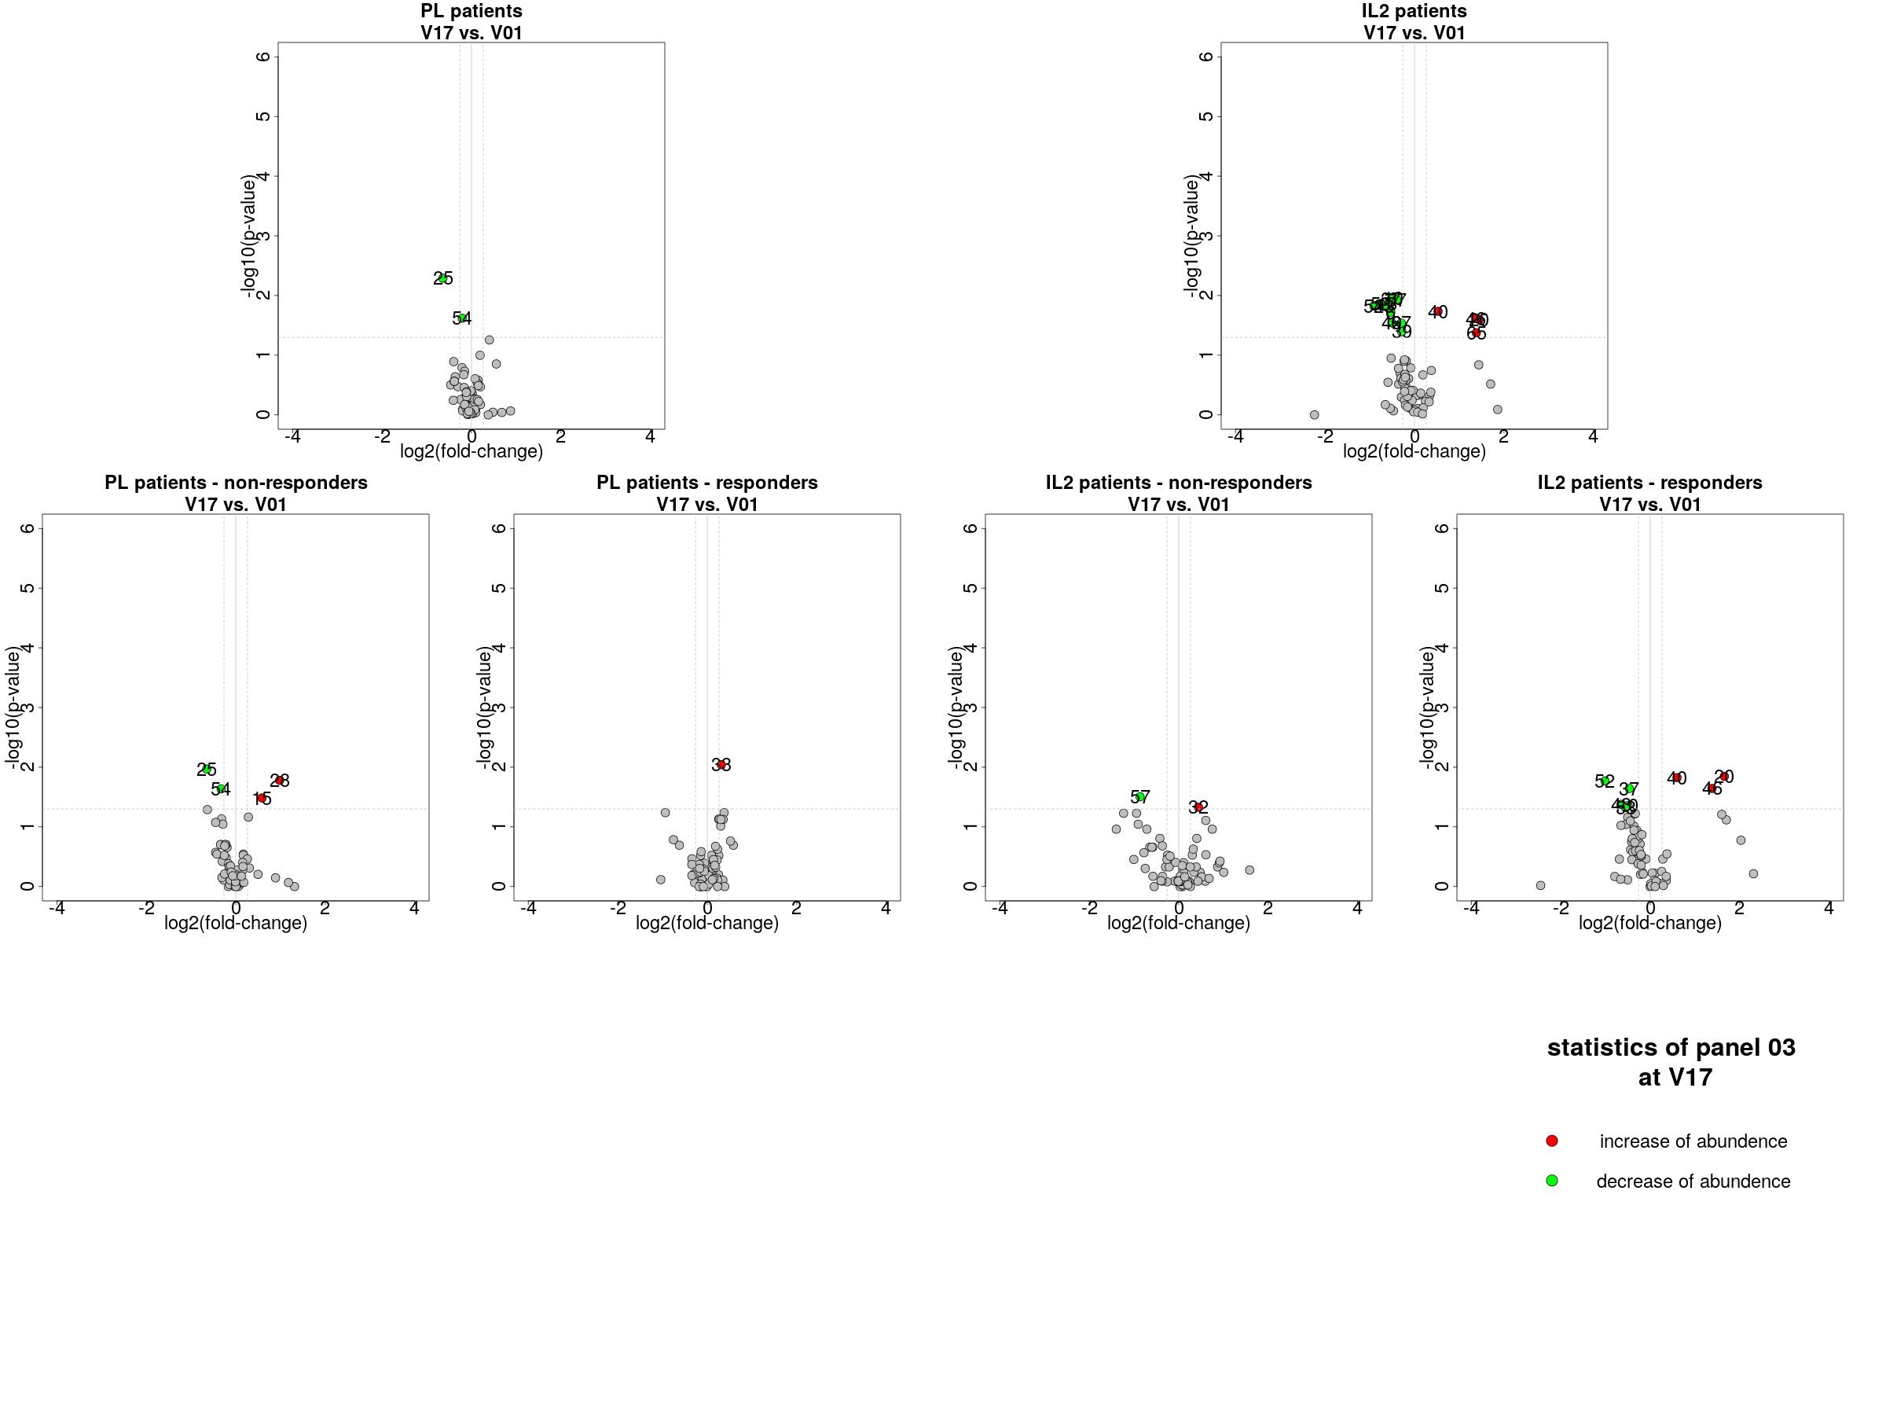
viSNE/kmeans analyses
This analytical pipeline can be used to study the change of cell cluster abundances over time
Panel 03 – NK cells
V17 vs. V01

Slide 44
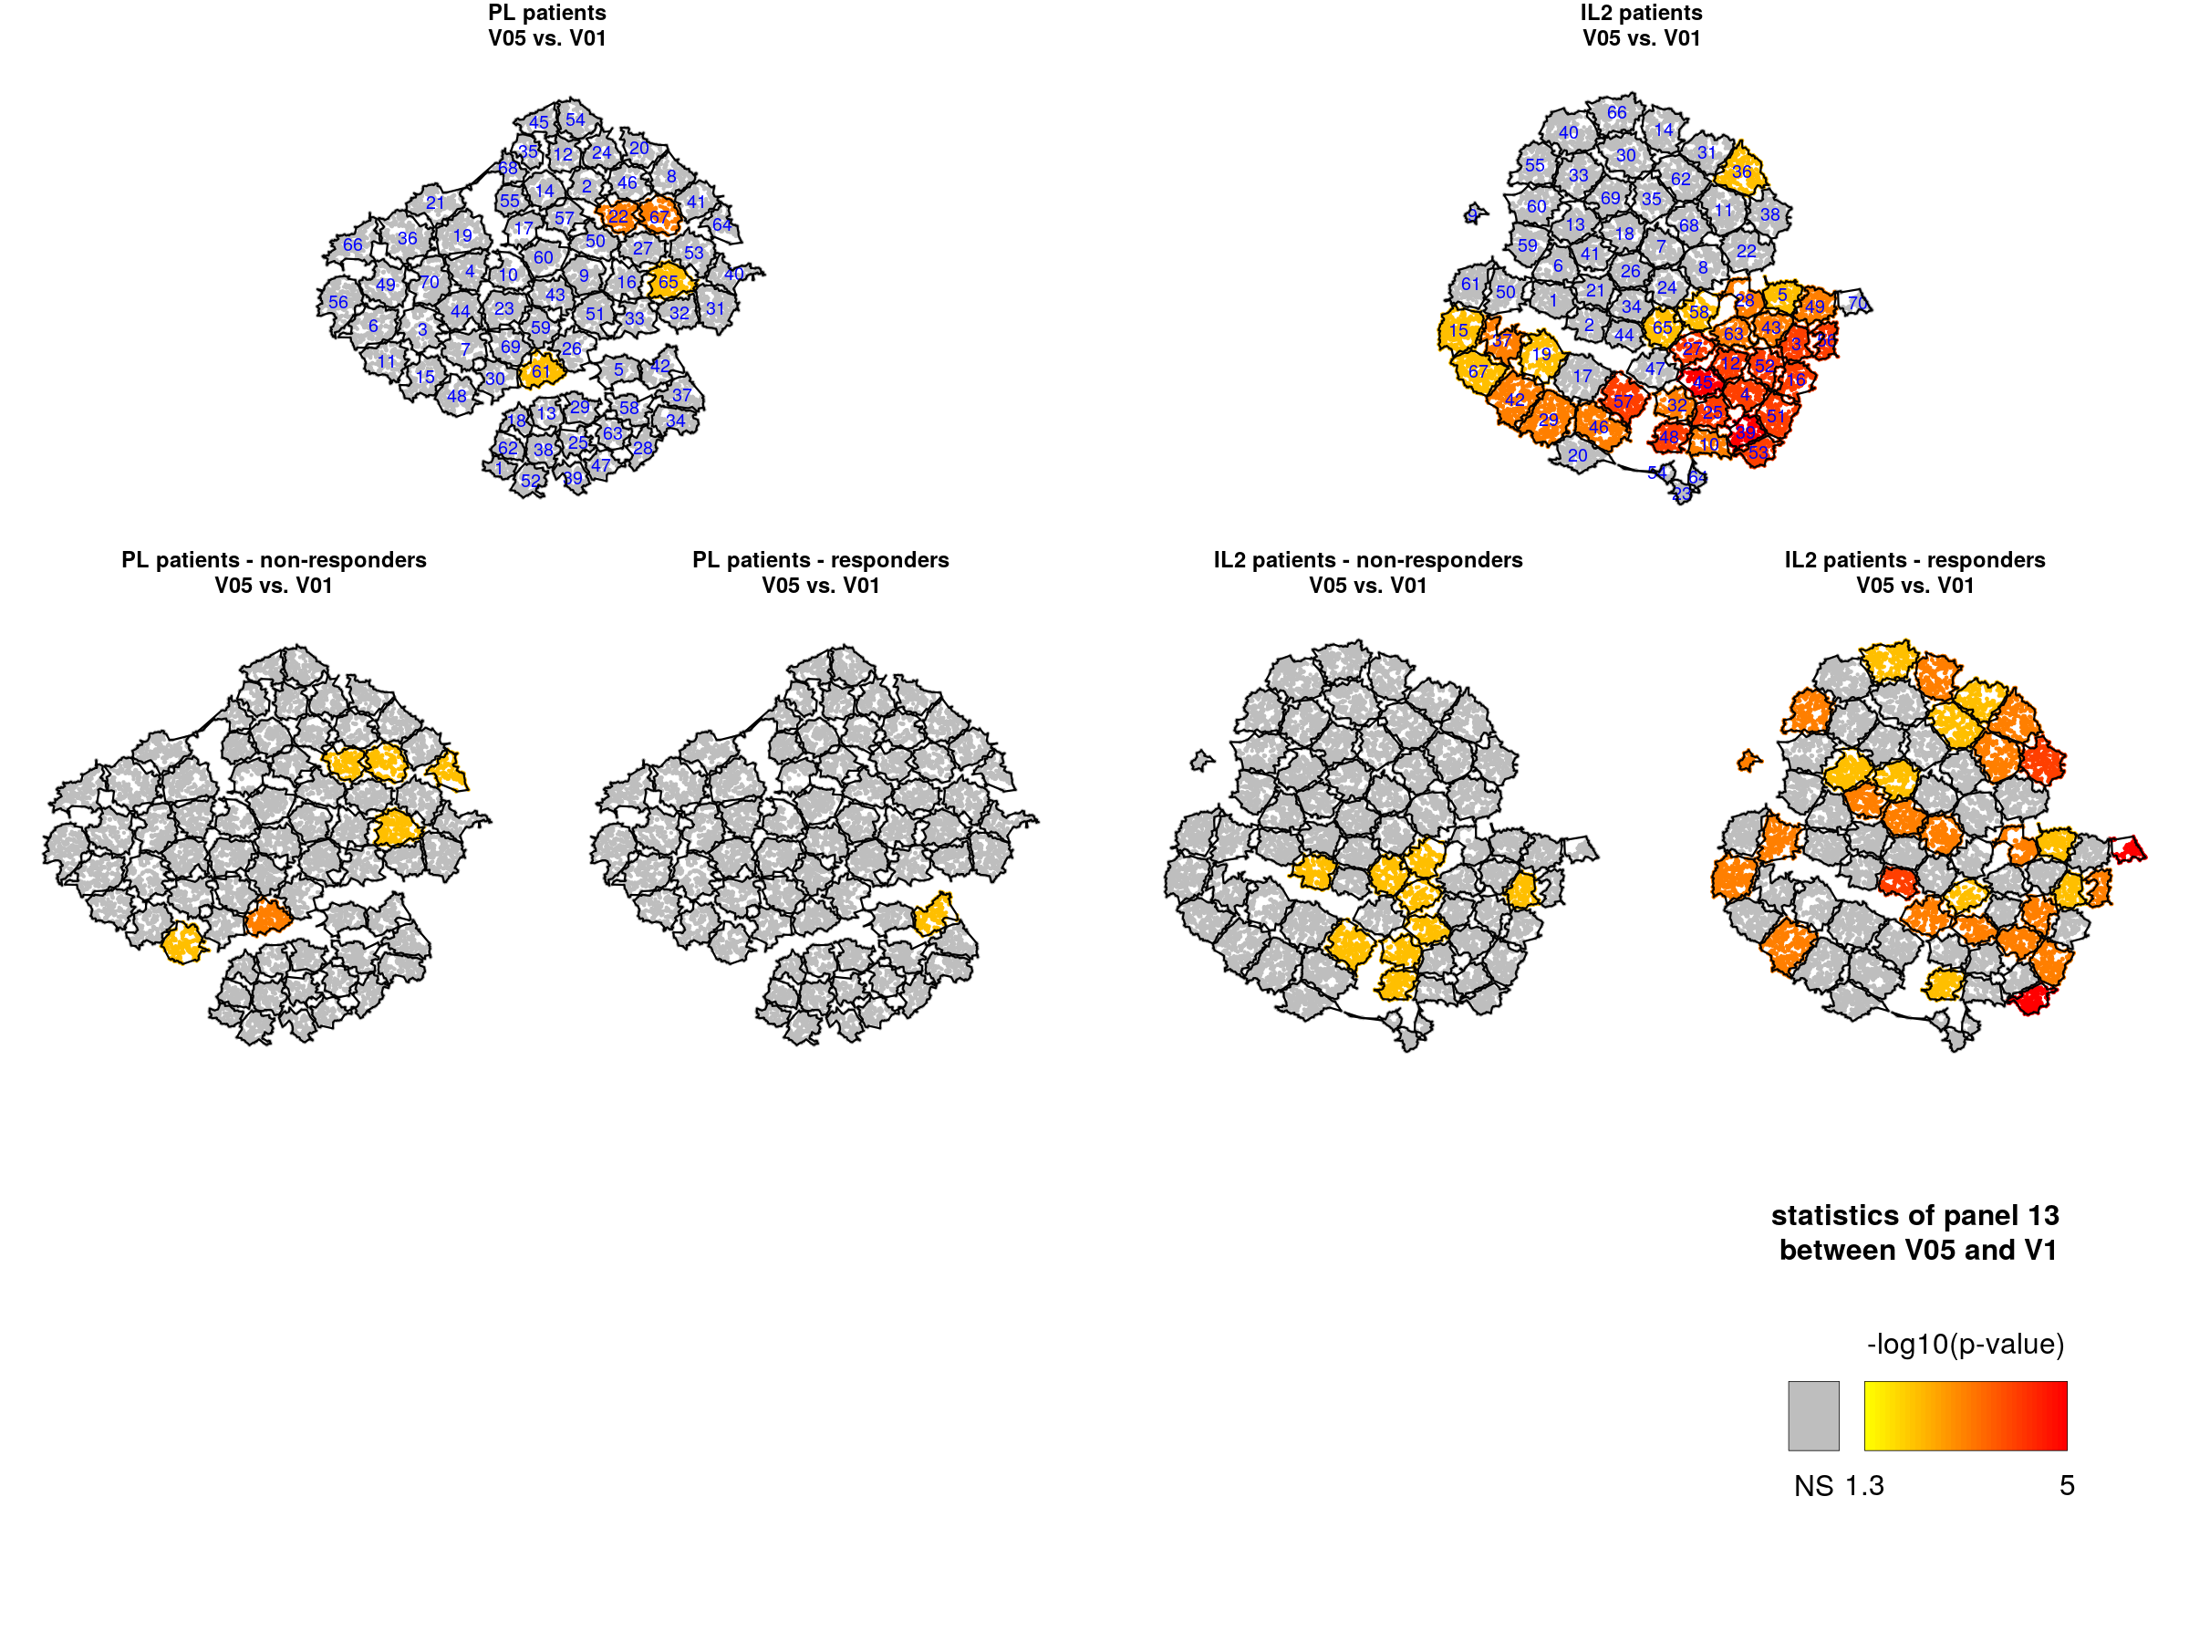
viSNE/kmeans analyses
Clusters 4-12-51-39-45→ ILC3 (CD117+/CD294-)
Cluster 57-46-29-42 → ILC2 (CD294+)
Clusters 36-38-11 → ILC1 (CD117-/CD294-)
Panel 13 – Innate Lymphoid Cells
V05 vs. V01

Slide 45
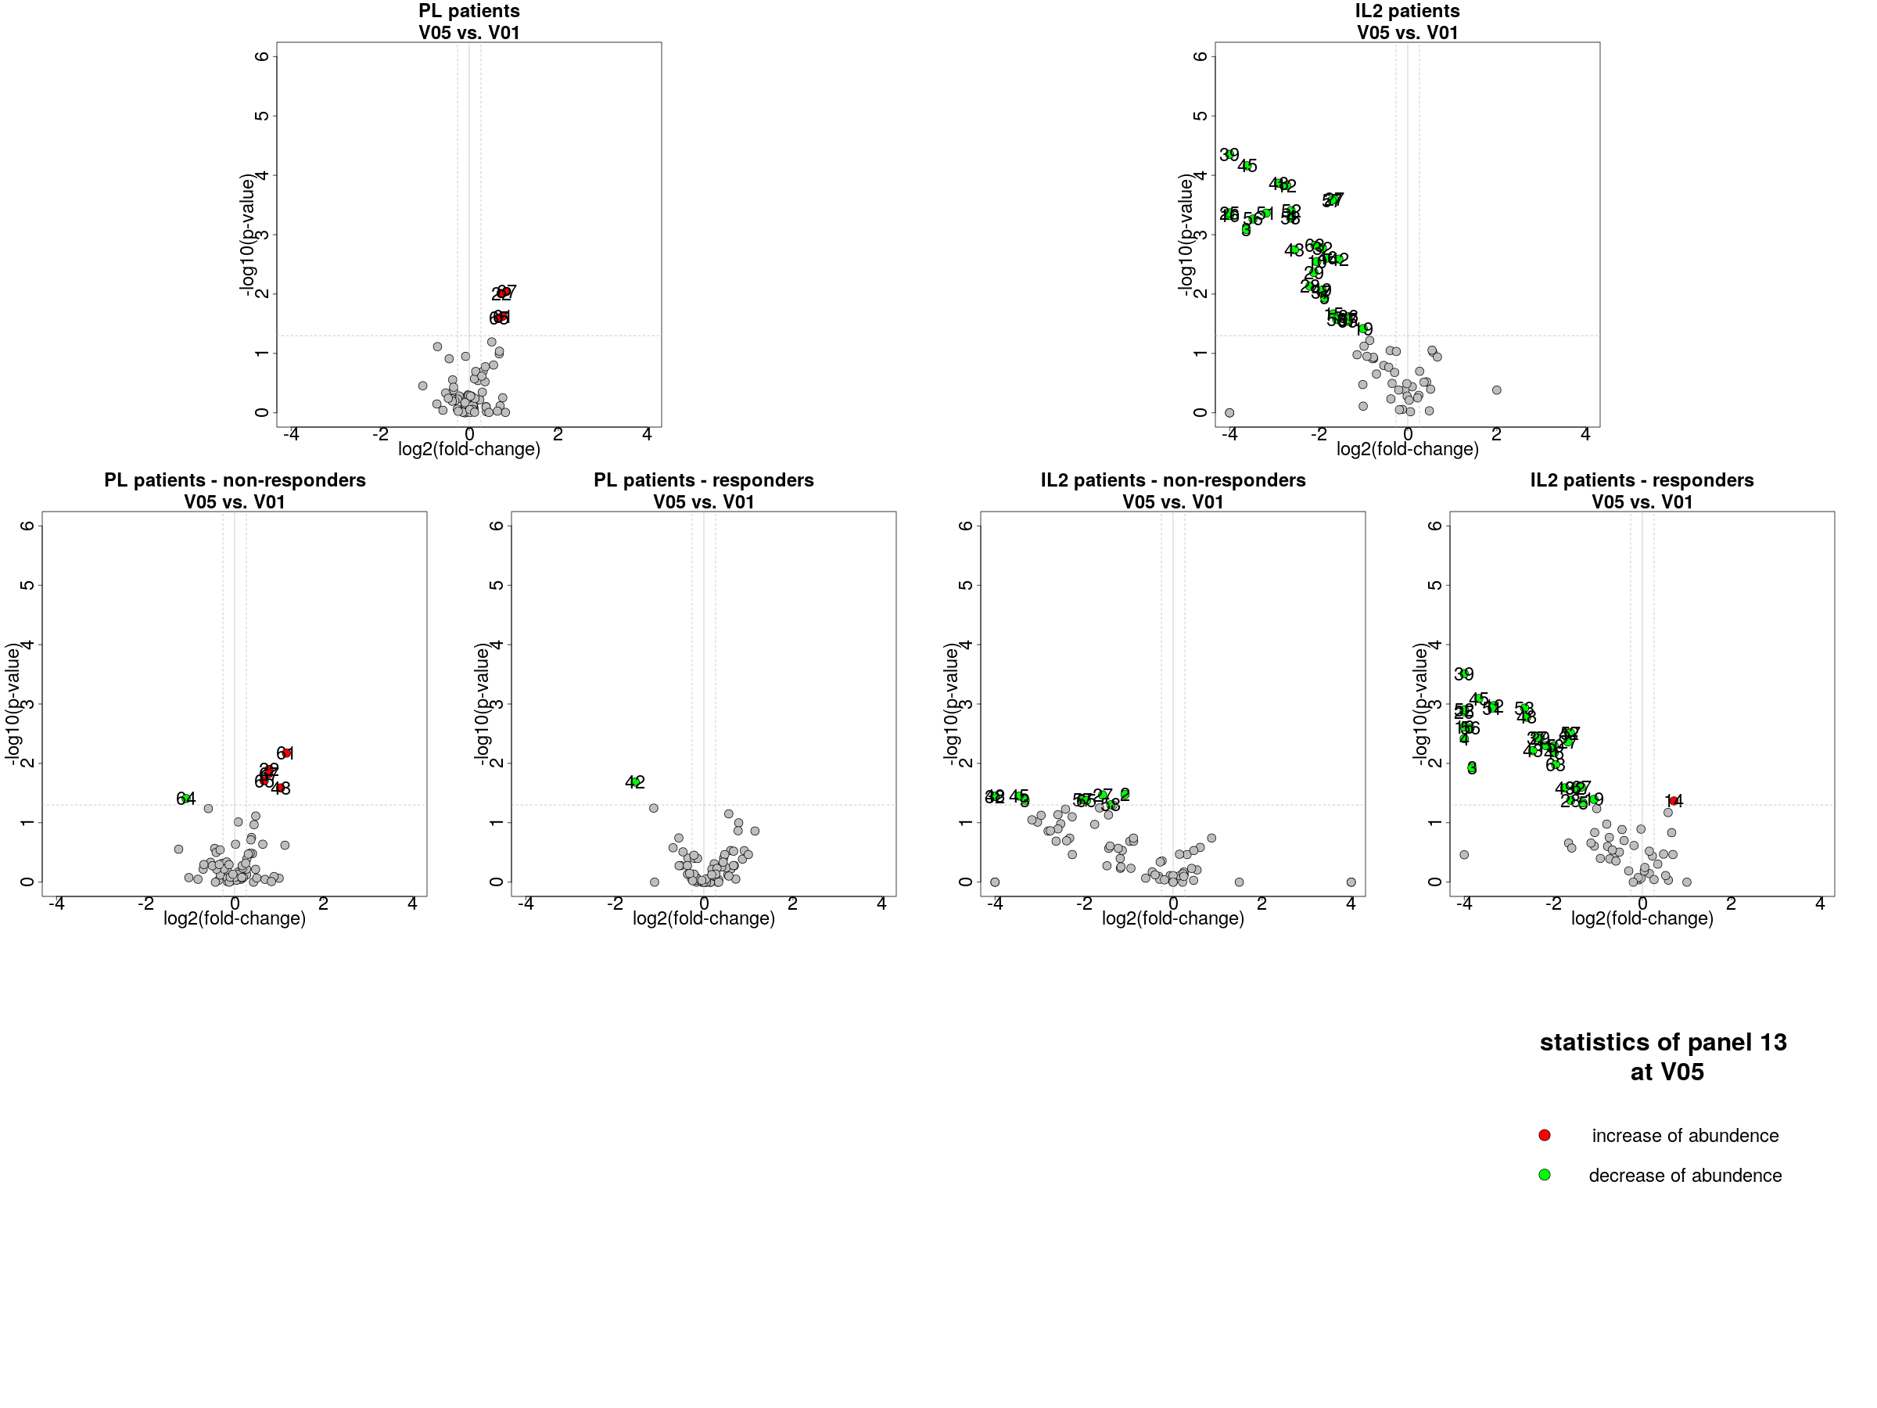
viSNE/kmeans analyses
Clusters 4-12-51-39-45→ ILC3 (CD117+/CD294-)
Cluster 57-46-29-42 → ILC2 (CD294+)
Clusters 36-38-11 → ILC1 (CD117-/CD294-)
Panel 13 – Innate Lymphoid Cells
V05 vs. V01
Panel 03 – NK cells
V17 vs. V01

Slide 46
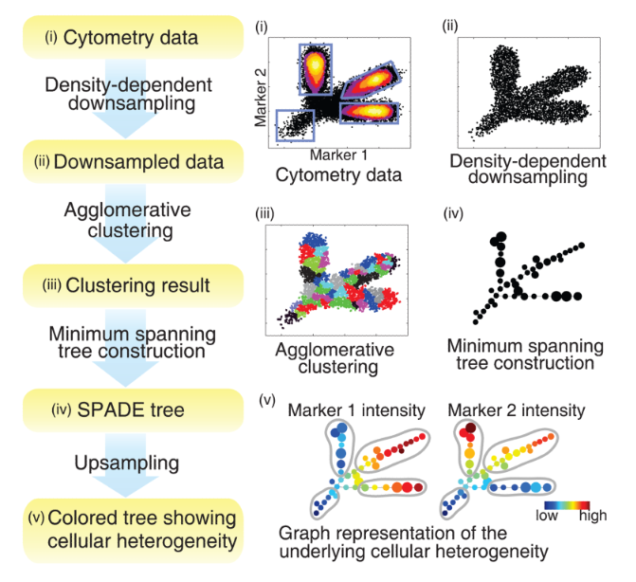
SPADE analyses
SPADE stands for "Spanning-tree Progression Analysis of Density-normalized Events“
SPADE performs a hierarchical clustering on cell phenotypes to identify clusters of similar cells
Performs a density-based down-sampling for each sample to balance the contribution of rare and abundance cell populations
K = the number of cell clusters to identify
D = the down-sampling parameter
C = the set of clustering markers

Slide 47
SPADE analyses
SPADE stands for "Spanning-tree Progression Analysis of Density-normalized Events“
SPADE performs a hierarchical clustering on cell phenotypes to identify clusters of similar cells
Performs a density-based down-sampling for each sample to balance the contribution of rare and abundance cell populations
K = the number of cell clusters to identify
D = the down-sampling parameter
C = the set of clustering markers
Use of the SPADEVizR package to determine optimal clustering parameters (K and D)

Slide 48
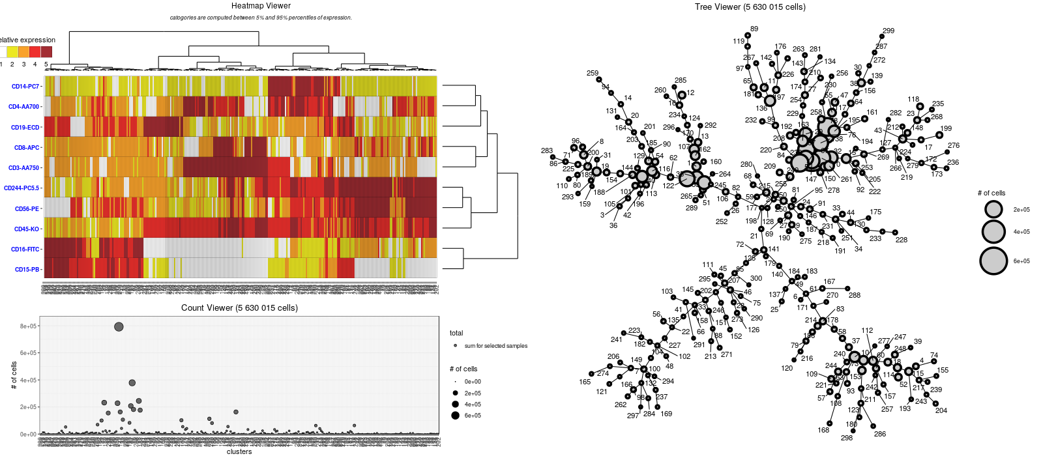
SPADE analyses
SPADE overlaid
Panel 01 – numeration cells – IL2-treated patients

Slide 49
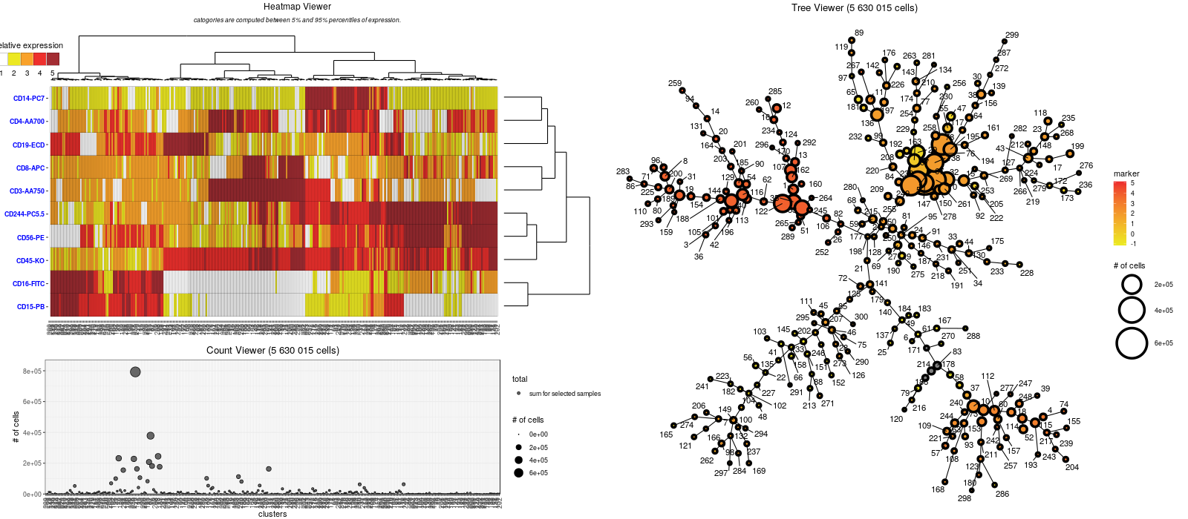
SPADE analyses
SPADE overlaid by CD3 expression
Panel 01 – numeration cells
Panel 01 – numeration cells – IL2-treated patients

Slide 50

SPADE analyses
SPADE overlaid by CD4 expression
CD4
Panel 01 – numeration cells
Panel 01 – numeration cells – IL2-treated patients

Slide 51

SPADE analyses
SPADE overlaid by CD8 expression
CD8
Panel 01 – numeration cells
Panel 01 – numeration cells – IL2-treated patients

Slide 52
SPADE analyses
Panel 01 – numeration cells – IL2-treated patients

Slide 53
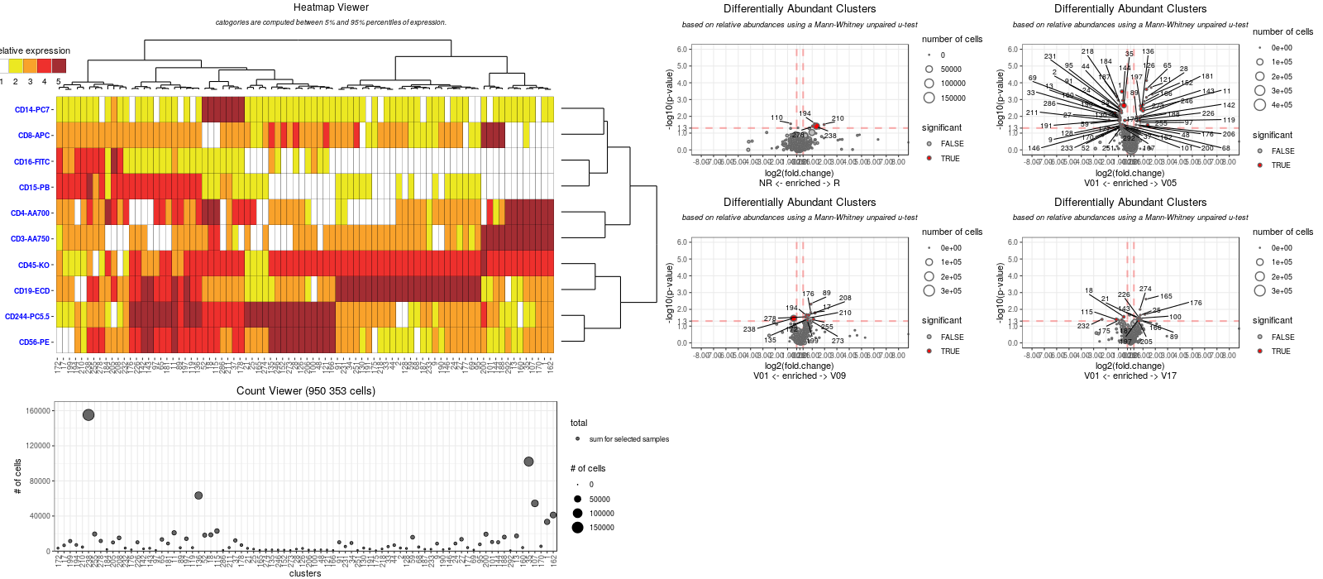
SPADE analyses
Panel 01 – numeration cells – IL2-treated patients

Slide 54
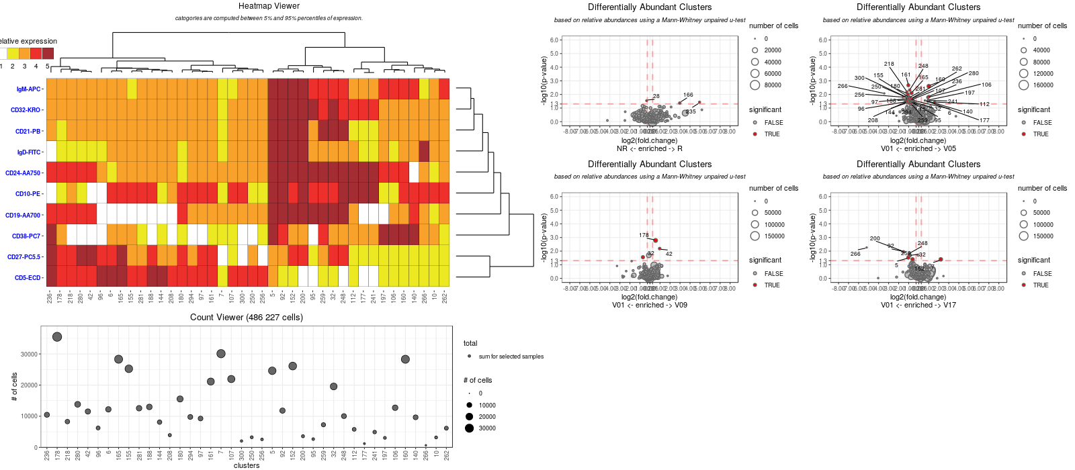
SPADE analyses
Panel 02 – B cells – IL2-treated patients

Slide 55
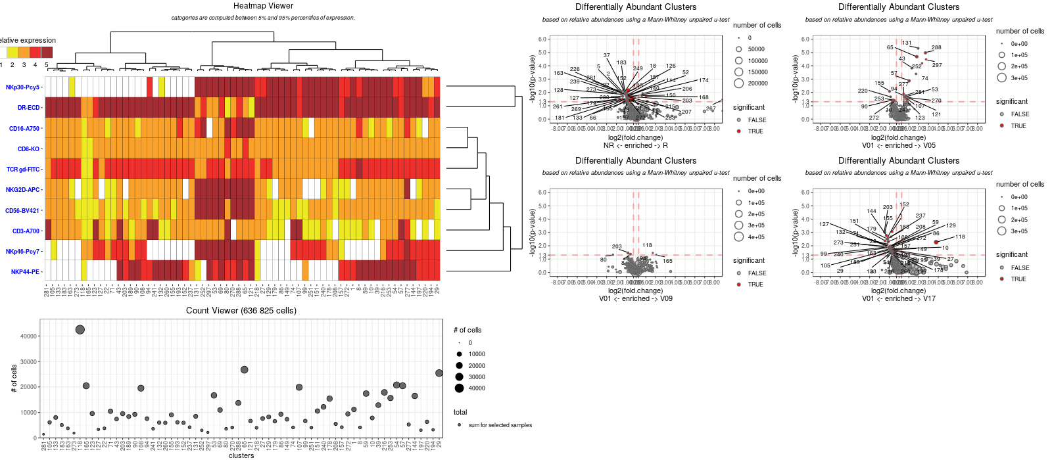
SPADE analyses
Clusters 297-288-65 → activated NK cells (NKp46⁺/NKp30⁺/NKG2D⁺)
Cluster 43 → TCRγδ⁺
Panel 03 – NK cells – IL2-treated patients

Slide 56
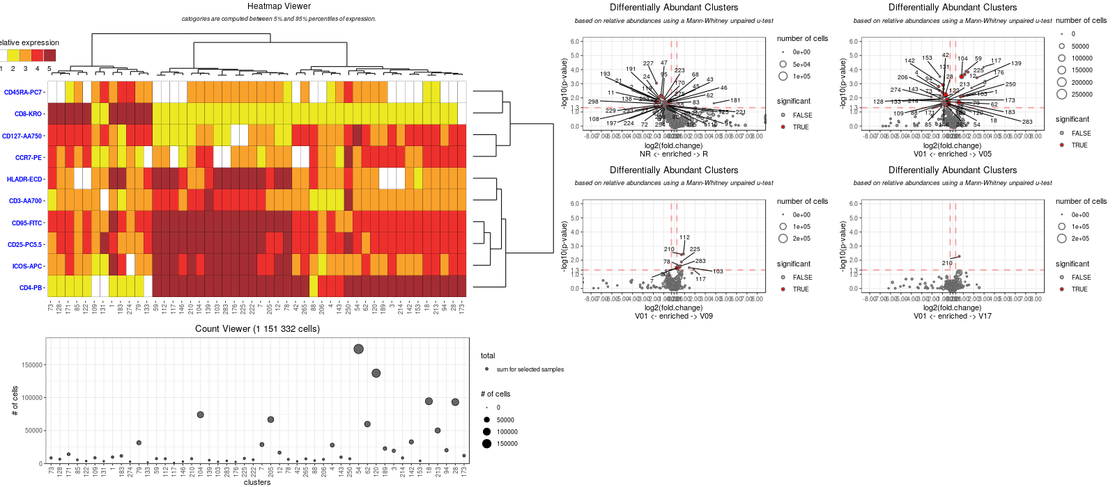
SPADE analyses
Panel 04 – Naïve memory T cells – IL2-treated patients

Slide 57
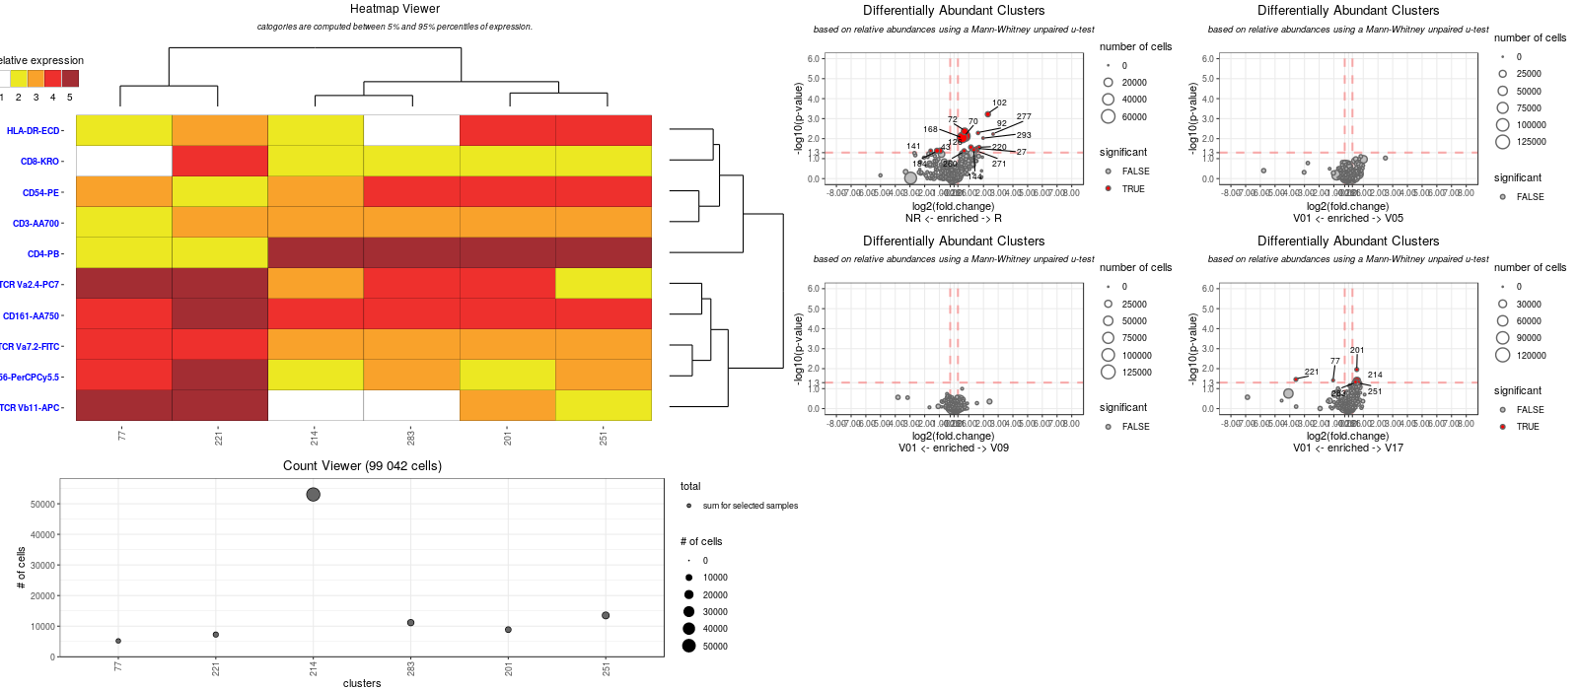
SPADE analyses
Panel 05 – NK/MAIT cells – IL2-treated patients

Slide 58
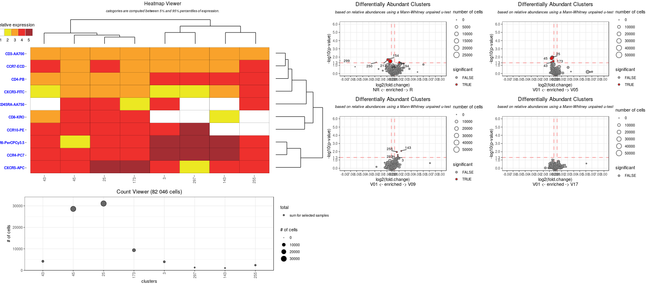
SPADE analyses
Panel 08 – T cells polarization – IL2-treated patients

Slide 59
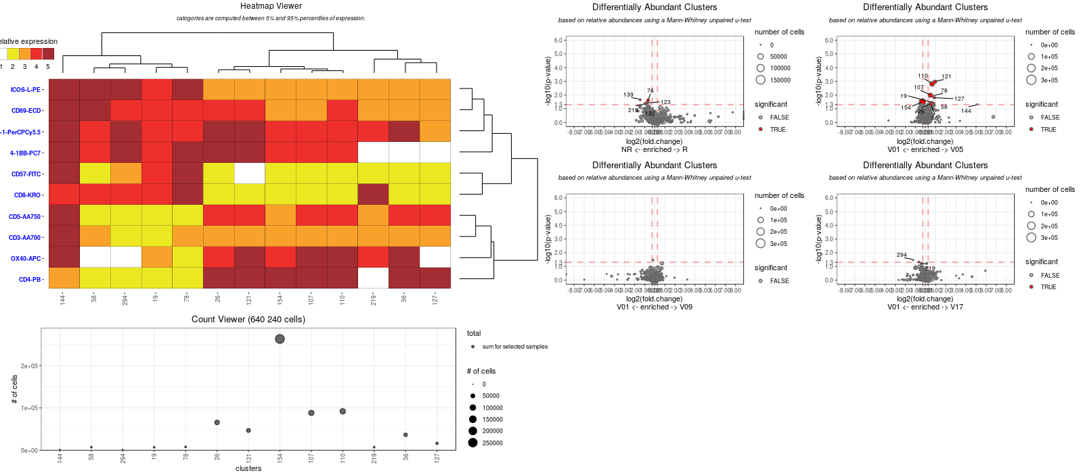
SPADE analyses
Panel 09 – T cells activation – IL2-treated patients

Slide 60
Cytokine data

Slide 61
Overview of the collected samples
61 patients
30 placebo (13 R and 17 NR)
31 IL2-treated (22 R and 9 NR)
7 clinical centers
France (003)
Germany (004)
Mexico (006)
Portugal (007)
Romania (008)
Spain (009)
Mauritius (010)
6 time-points
V01: baseline (before treatment)
V05: D05
V09: D30
V17: M03
V29: M06
V30: M09

Slide 62
Aim of the cytokine analyses
Understand the biology of the low-dose IL2 treatment
What cytokines are impacted by the treatment over time ?
Predict patient’s outcomes based on cytokine expressions
What cytokines are associated at baseline with the clinical outcomes ?
Understand the impact of the cytokines on cellular and molecular mechanisms
What cell populations are associated with cytokine expressions?
What genes/transcripts are associated with cytokine expressions?

Slide 63
Overview of the Multiplex kits
5 MILLIPLEX MAP kits:
Human Cytokine/Chemokine Magnetic Bead Panel 36 cytokines
Human Th17 Magnetic Bead Panel + 11 cytokines
Human Soluble Cytokine Receptor Magnetic Bead Panel + 14 cytokines
Human High Sensitivity T Cell Magnetic Bead Panel + 13 cytokines
Human TGFβ Single Plex Magnetic Bead Panel + 1 cytokine
+ 75 cytokines

Slide 64
Overview of the Multiplex kits
Human Cytokine/Chemokine Magnetic Bead Panel
sCD40L, EGF, FGF-2, Fractalkine, G-CSF, GM-CSF, GRO, IFN-α2, IFN-γ, IL-1α, IL-1β, IL-1ra, IL-2, IL-3, IL-4, IL-5, IL-6, IL-7, IL-8, IL-9, IL-10, IL-12 (p40), IL-12 (p70), IL-13, IL-15, IP-10, MCP-1, MCP-3, MDC (CCL22), MIP-1α, MIP-1β, TGF-α, TNF-α, TNF-β, VEGF, Eotaxin/CCL11
Human Soluble Cytokine Receptor Magnetic Bead Panel
sCD30, sEGFR, sgp130, sIL-1RI, sIL-1RII, sIL-2Rα, sIL-4R, sIL-6R, sRAGE, sTNFRI, sTNFRII, sVEGF-R1, sVEGF-R2, sVEGF-R3
Human High Sensitivity T Cell Magnetic Bead Panel
GM-CSF, IFNγ, IL-1β, IL-2, IL-4, IL-5, IL-6, IL-7, IL-8, IL-10, IL-12 (p70), IL-13, TNF-α
Human Th17 Magnetic Bead Panel IL-17A, IL-17F, IL-17E/IL-25, IL-21, IL-22, IL-23, IL-27, IL-28A, IL-31, IL-33, MIP-3α/CCL20
Human TGFβ Single Plex Magnetic Bead Panel TGF-β1

Slide 65
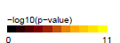
The main correlations between cytokines/ chemokines are within the different MILLIPLEX Kits
PCC
Human Th17 Magnetic Bead Panel
Human Soluble Cytokine Receptor Magnetic Bead Panel
Human High Sensitivity T Cell Magnetic Bead Panel
Human Cytokine/Chemokine Magnetic Bead Panel
Human TGFβ Single Plex Magnetic Bead Panel

Slide 66
The main correlations between cytokines/ chemokines are within the different MILLIPLEX Kits
PCC
Human Soluble Cytokine Receptor Magnetic Bead Panel
Human High Sensitivity T Cell Magnetic Bead Panel

Slide 67
The correlations between the high sensitivity kit and classical kit measurements are limited
IL-8 and TNFa
IL-13, IL-6, IL-4, IL-7, IFNg, IL-5, IL-2
IL-10, GM-CSF, IL-1b, IL-12p70

Slide 68
Analysis strategies
Statistical analyses
Univariate analyses (overtime or between conditions)
Multivariate analyses (ML algorithms to distinguish conditions)
Cross-panel multivariate analyses (ML algorithms to distinguish conditions)

Slide 69
Analysis strategies
Statistical analyses
Univariate analyses (overtime or between conditions)
Multivariate analyses (ML algorithms to distinguish conditions)
Cross-panel multivariate analyses (ML algorithms to distinguish conditions)
Systematically performed at different levels:
Expression levels
Fold-change relative to baseline
AUC from V01 to V17

Slide 70
Differential analysis (all timepoints)

Slide 71

Differential analysis at baseline

Slide 72

Differential analysis at V05

Slide 73

Differential analysis at V09

Slide 74

Differential analysis at V17

Slide 75

Differential analysis

Slide 76
Kinetics analyses
Identification of cytokine statistically differently expressed in at least one timepoint relative to baseline
Expression levels
Fold-change relative to baseline

Slide 77
Differential Analysis based on AUC values

Slide 78


Multivariate analysis (LASSO analysis) to predict responder vs. non-responders at V01
IL2-treated patients

Slide 79


Multivariate analysis (LASSO analysis) to predict responder vs. non-responders at V01
placebo patients

